Slide 1
Laha: A Framework for adaptive optimization of distributed sensor frameworks
Anthony christe
24 February 2020

Slide 2


DSNs and DSN management: The big picture

Slide 3
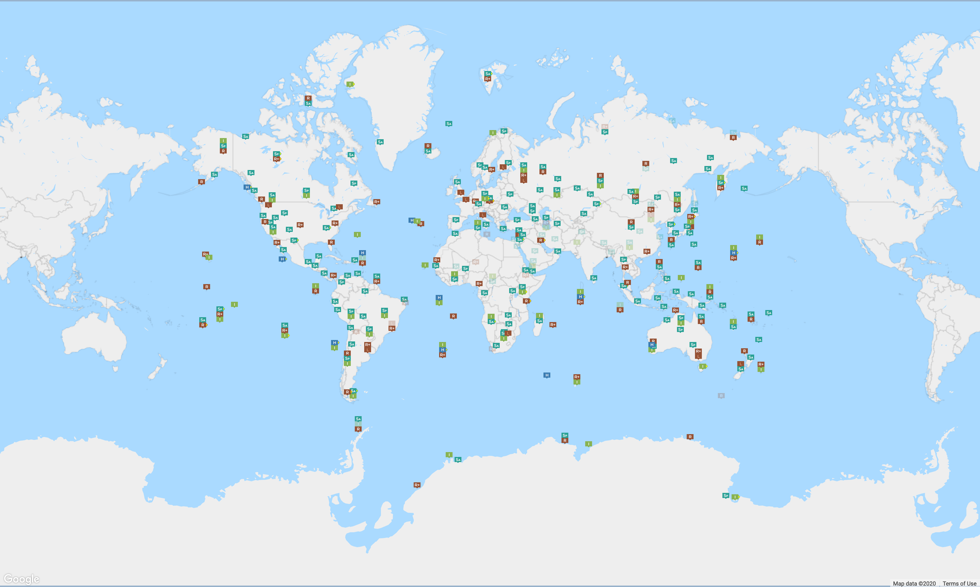
Distributed sensor networks
Source: CTBTO

Slide 4
Laha: addressing DSN issues
Laha is an abstract distributed sensor framework that
Transforms primitive sensor data into actionable insights
Management of sensor data storage, retention, and analysis
Scales with minimal system degradation
Is general enough to apply to multiple DSN domains
Works with heterogenous and dynamic sensors
Provides predictive analytics
Provides self-optimization capabilities

Slide 5
Laha: A Framework for addressing DSN issues
These capabilities were evaluated and tested in the following ways:
Design of two Laha-compatible DSNs
Deployment of two Laha-compatible DSNs
Validation of data collected by deployments
Evaluation of major goals of Laha
Results showing the effectiveness of Laha through the results and evaluation of the Laha-compatible DSNs

Slide 6
Major claims of the laha framework
General and useful framework for multiple DSN domains
Convert primitive sensor data into actionable insights
Tiered management of Big Data
Tertiary goals and claims. Optimization of:
Triggering
Detection/Classification
Predictive analytics
Sensing field topology

Slide 7
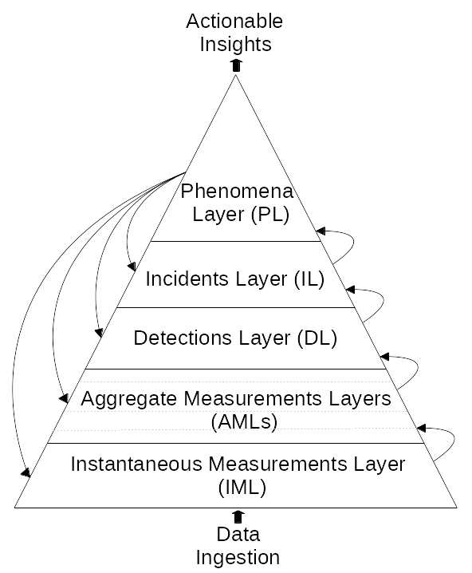
Contribution #1: Laha design
Novel abstract distributed sensor framework
Converting primitive data into actionable insights
Sensor data management
Self-optimization capabilities

Slide 8
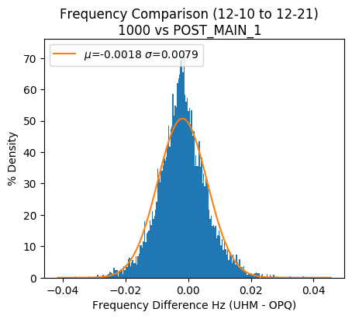
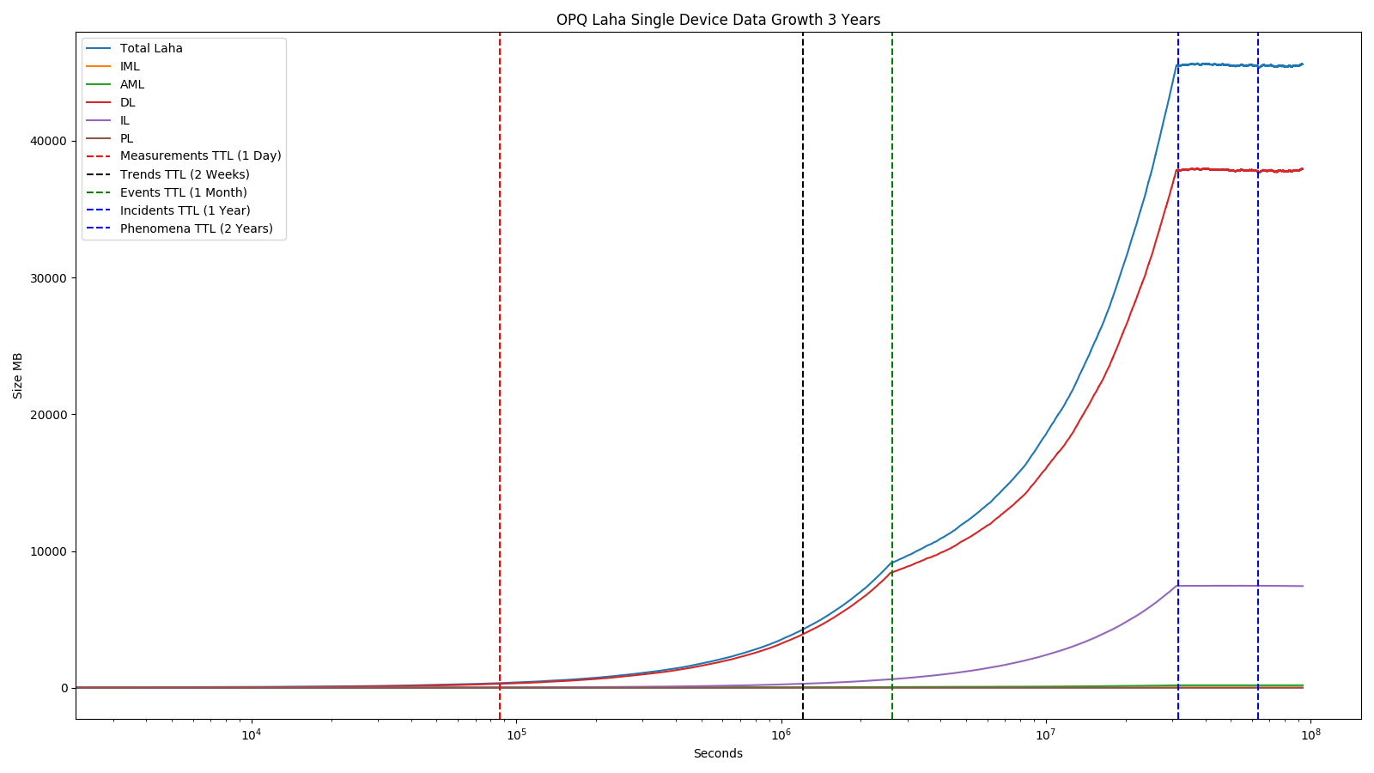
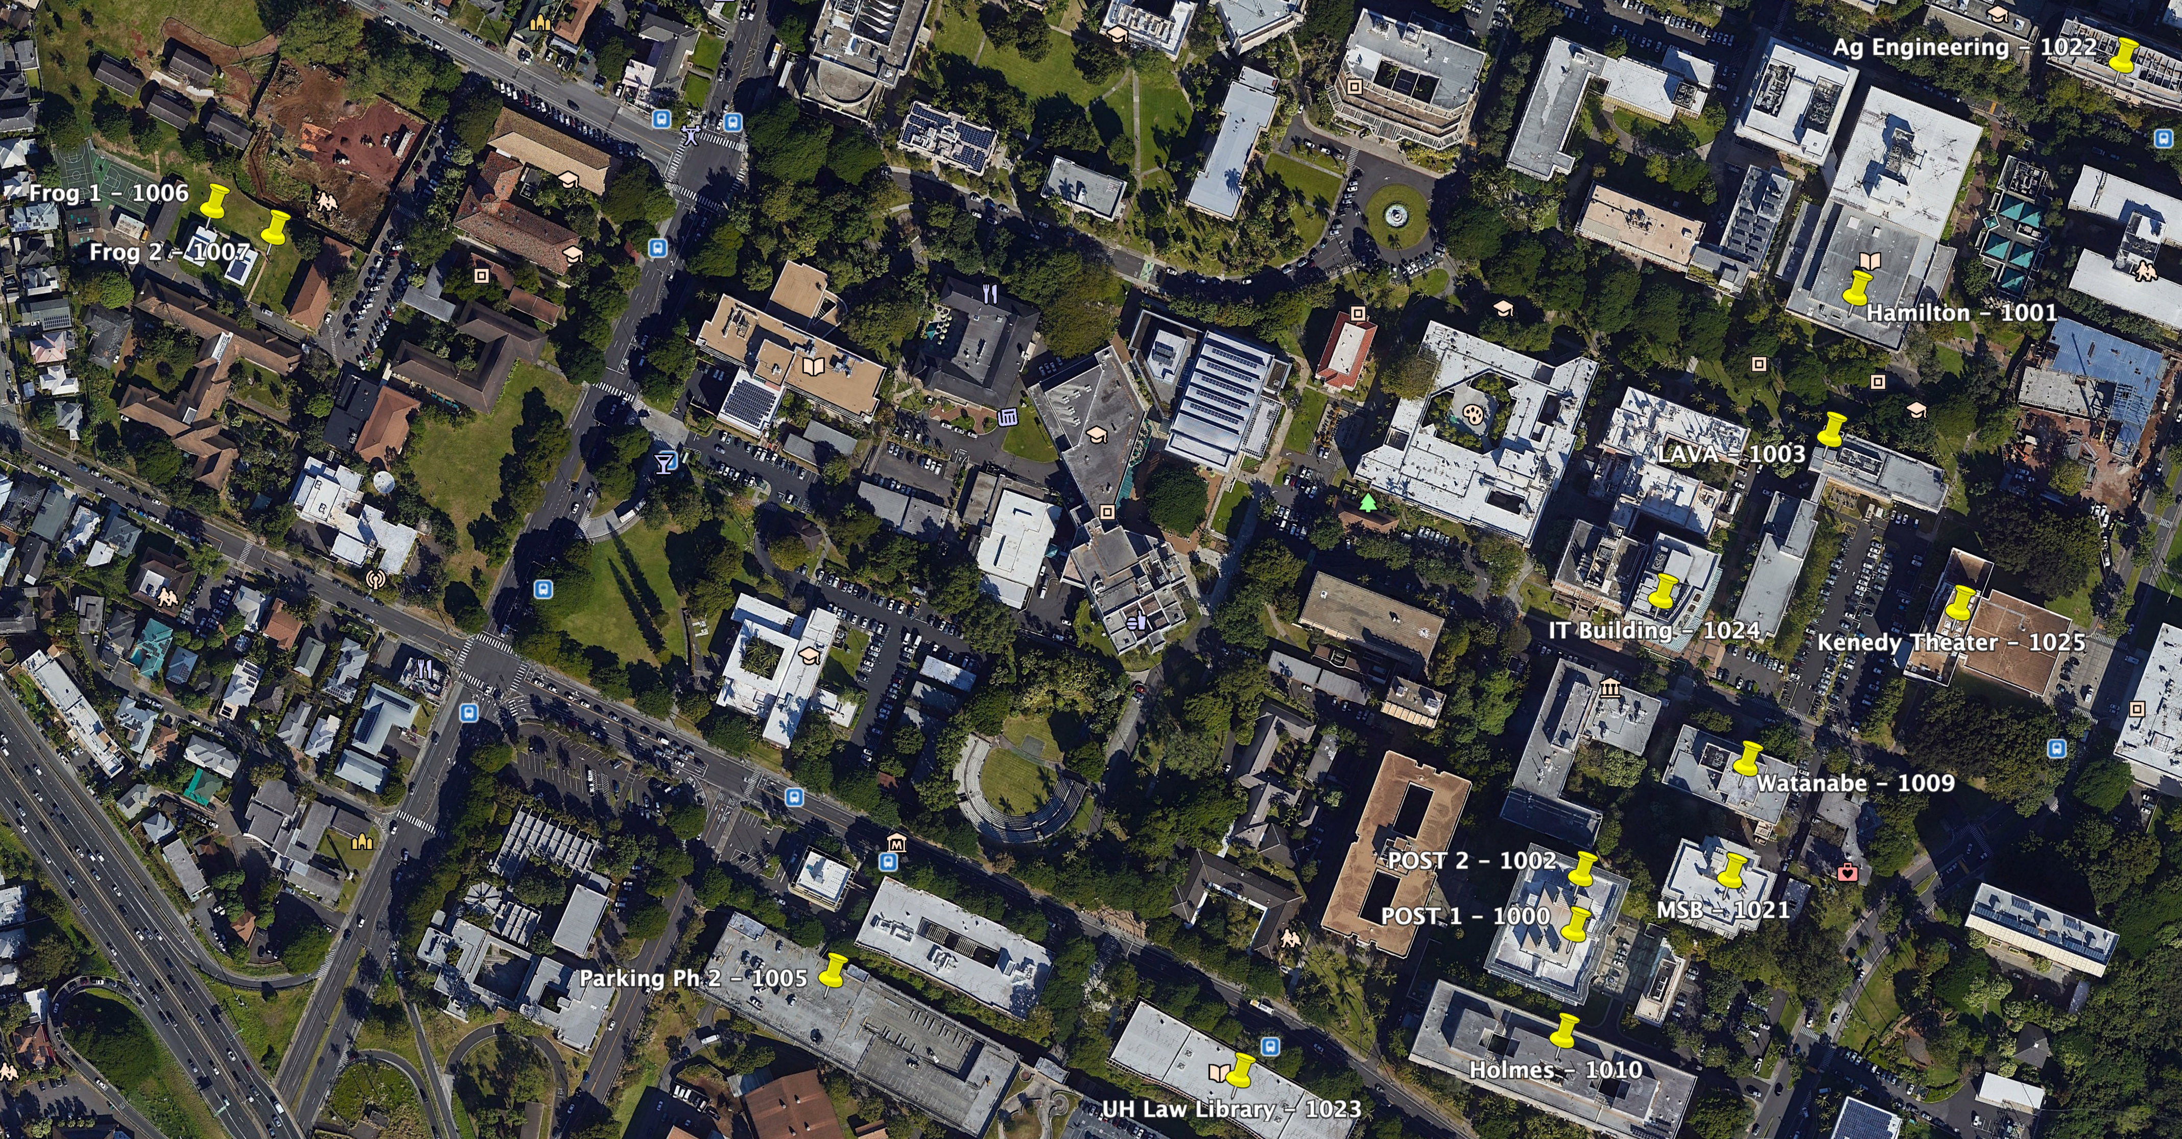
Contribution #2: Laha Evaluation
Deployment of two Laha-compatible DSNs
Validated data collection
Several experiments that test Laha’s major claims

Slide 9
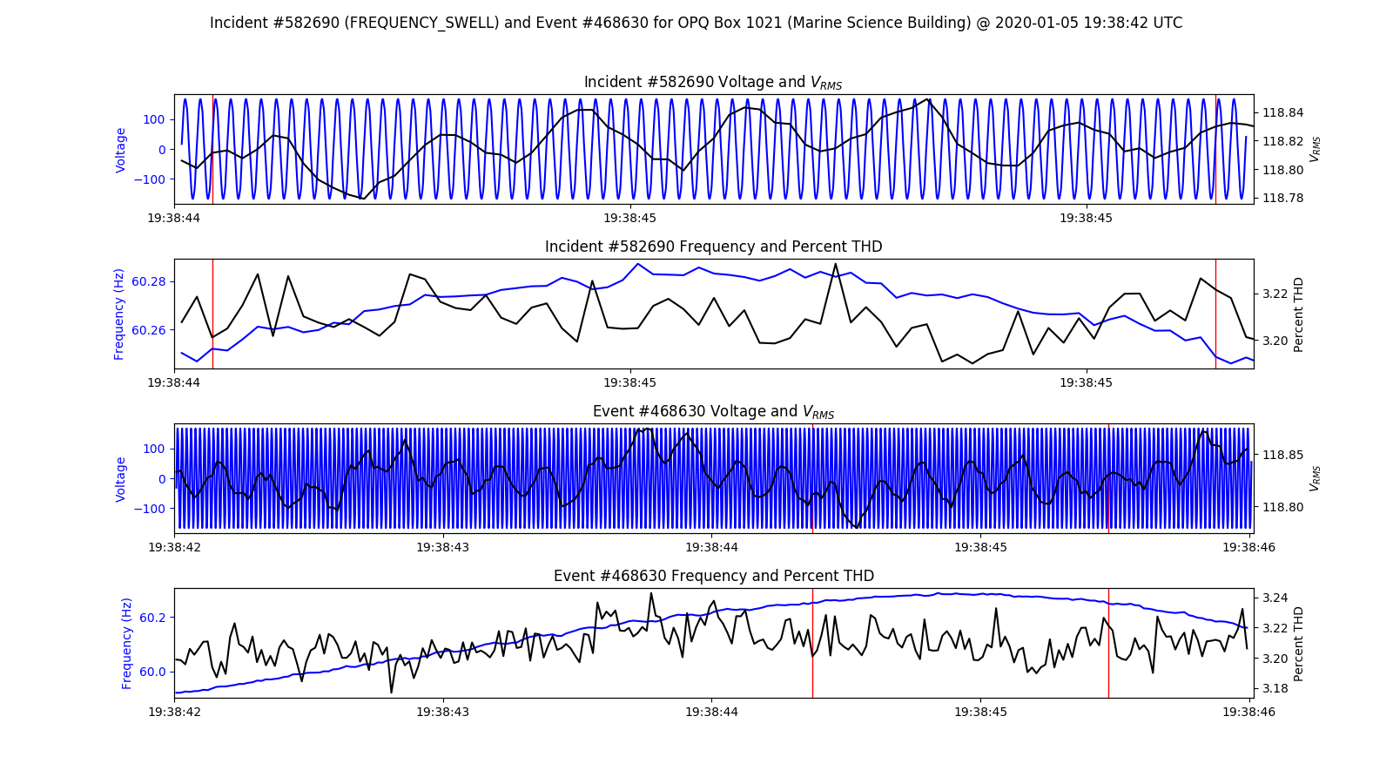
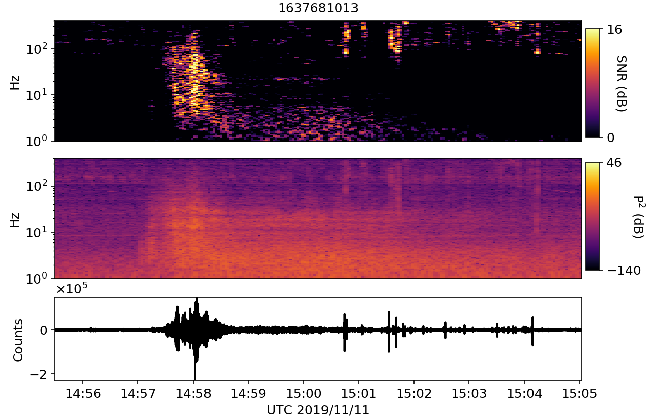
Contribution #3: Laha-compliant reference implementations
OpenPowerQuality (OPQ)
Distributed power quality (PQ) detection and analysis
Lokahi
Distributed infrasound detection and analysis

Slide 10
Contribution #4: Implications for modern DSNs
A set of implications for modern DSNs through the evaluation of Laha
Confirmation or denial of Laha’s benefits in relation to DSNs
Other domains that Laha is useful or not useful for
Source: CTBTO

Slide 11
Related work

Slide 12
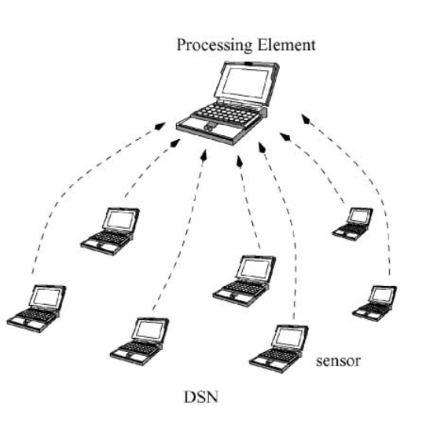
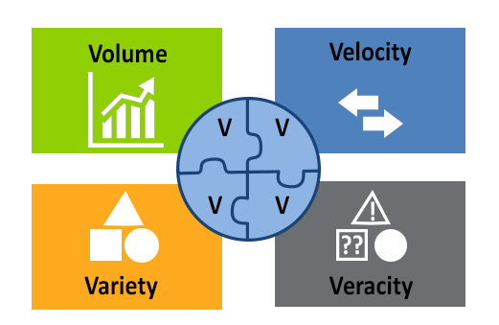
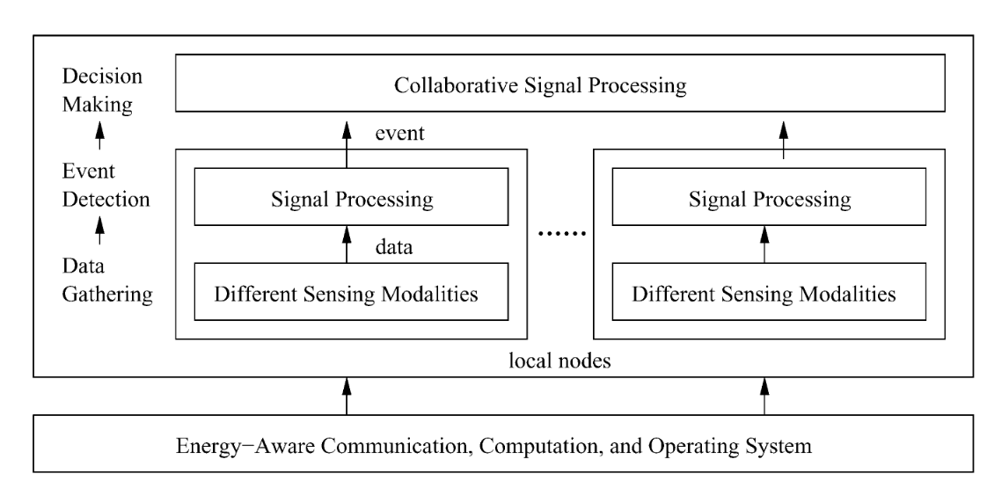
Big Data and Distributed Sensor Networks
REPORT TO THE PRESIDENT BIG DATA AND PRIVACY: A TECHNOLOGICAL PERSPECTIVE (PCAST 2016)
Undefined By Data: A Survey of Big Data Definitions (Ward et al 2013)
Distributed sensor networks -- review of recent research (Qi et al 2001)

Slide 13
Big data management for dsns

Slide 14
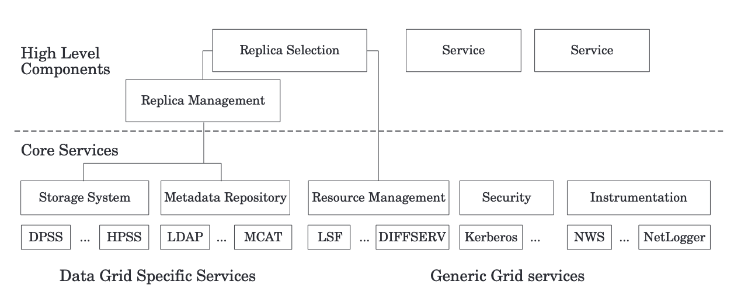
Data Grid (Chervenak et al 2000)

Slide 15
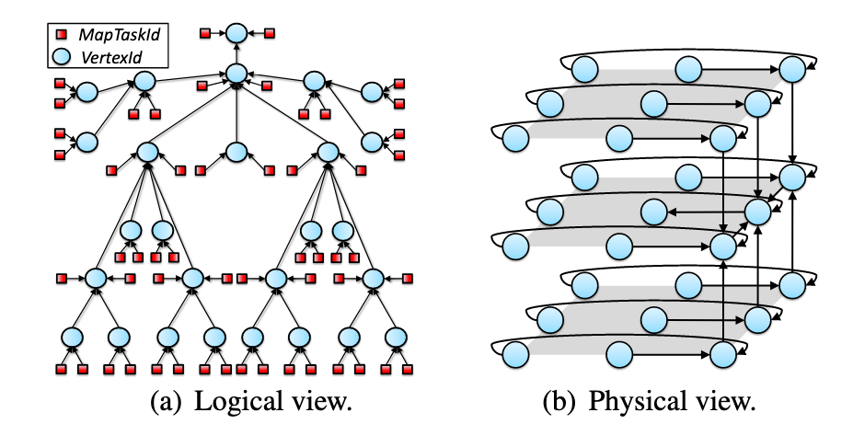
CAMDOOP (costa et al 2012)

Slide 16
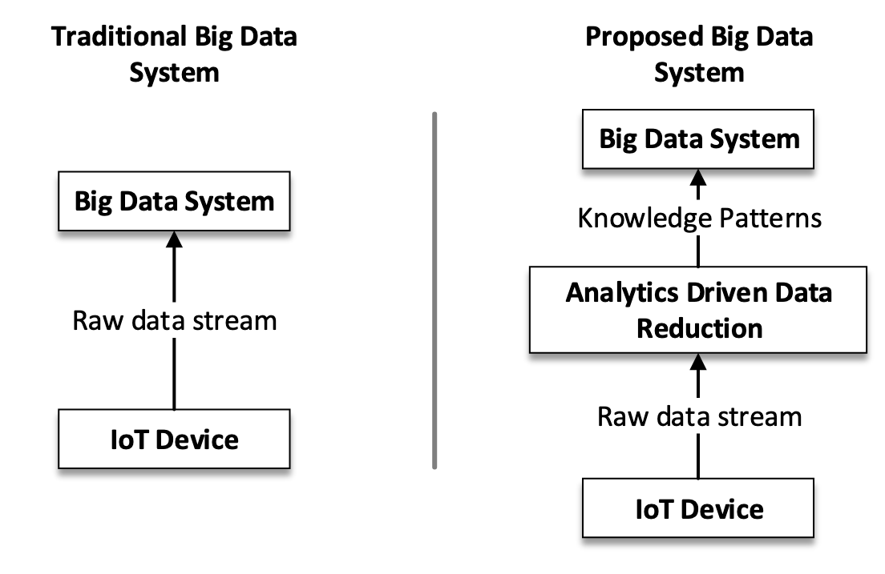
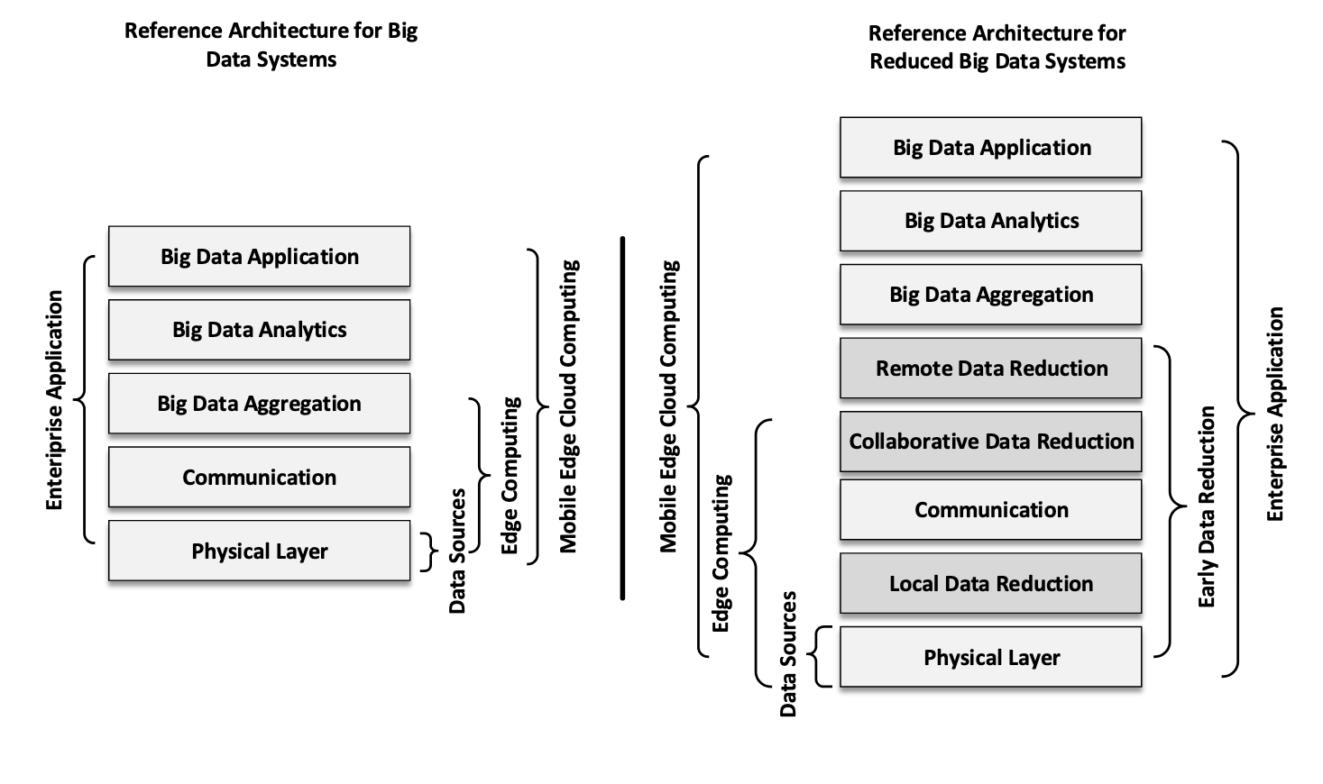
Big Data reduction framework (REHMAN et al 2016)

Slide 17
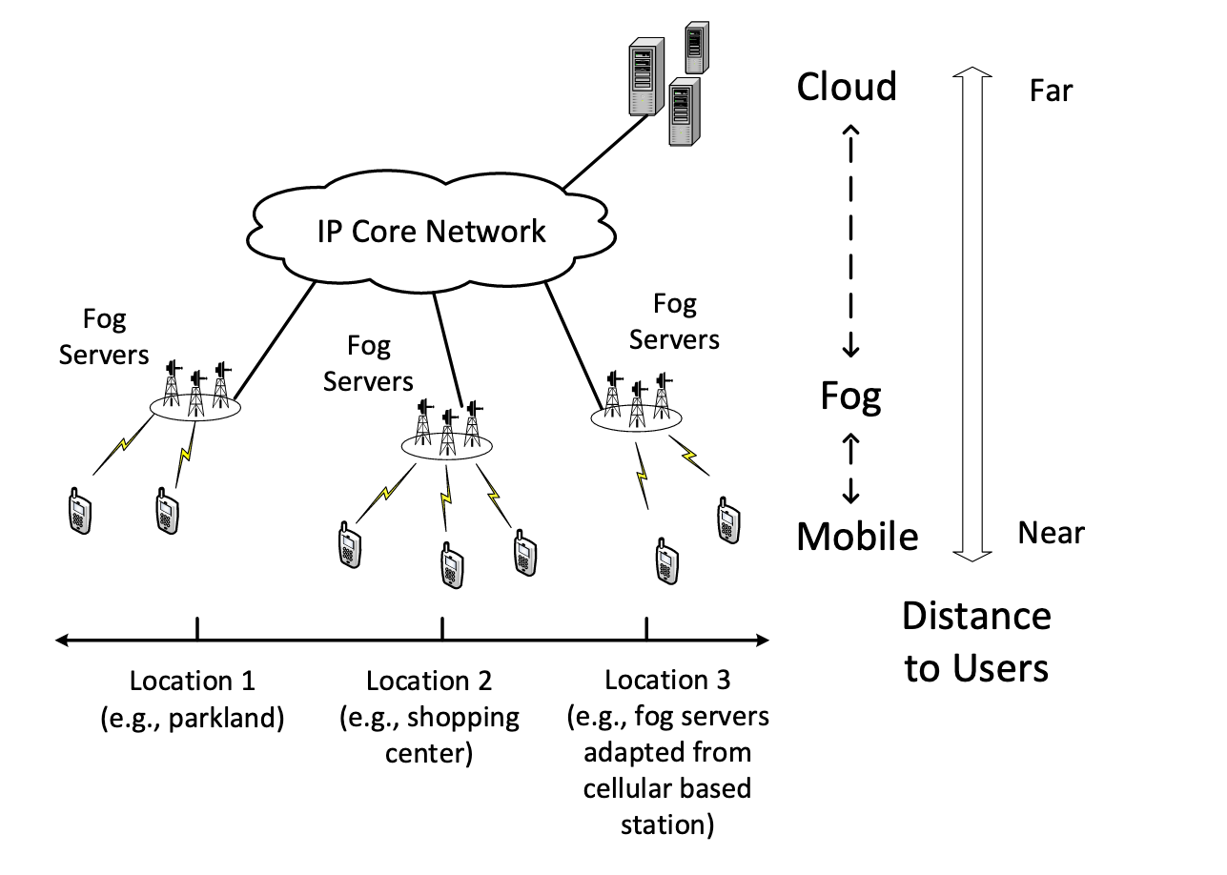
Fog Computing: Focusing on Mobile Users at the Edge (luan et al 2015)

Slide 18
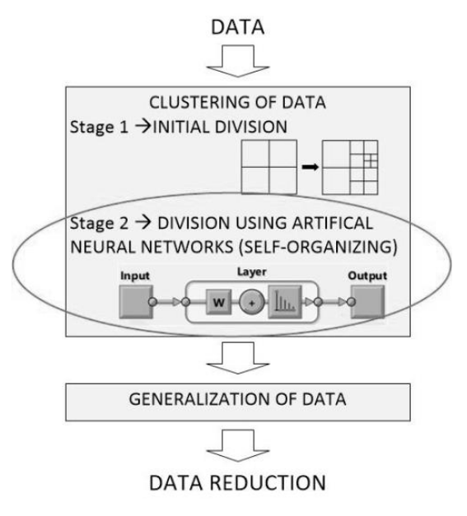
Self-organizing Artificial Neural Networks into Hydrographic Big Data Reduction Process (Stateczny et al 2014)

Slide 19
Predictive analytics and forecasting for dsns

Slide 20
Energy conservation in wireless sensor networks: A survey (anastasi et al 2009)

Slide 21
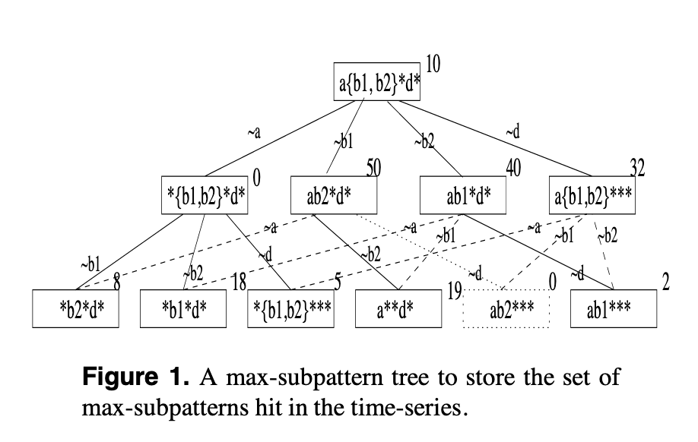
Efficient Mining of Partial Periodic Patterns in Time Series Database (HAN et al 1999)

Slide 22
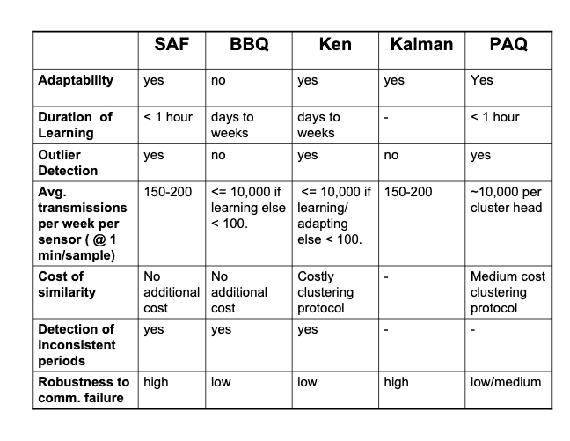
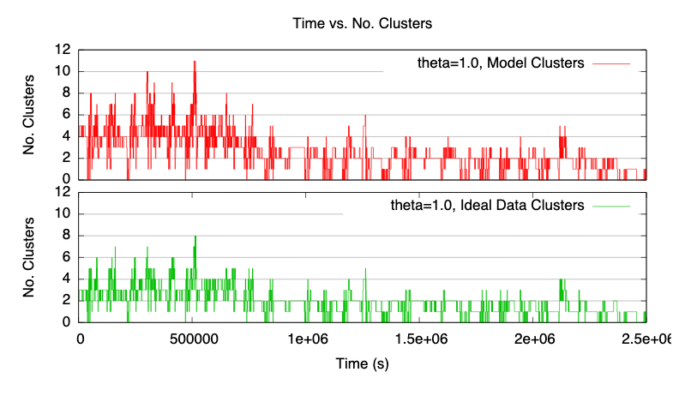
An Energy-efficient Querying Framework In SensorNetworks For Detecting Node Similarities (TULONE et al 2006)

Slide 23
Topology and localization

Slide 24
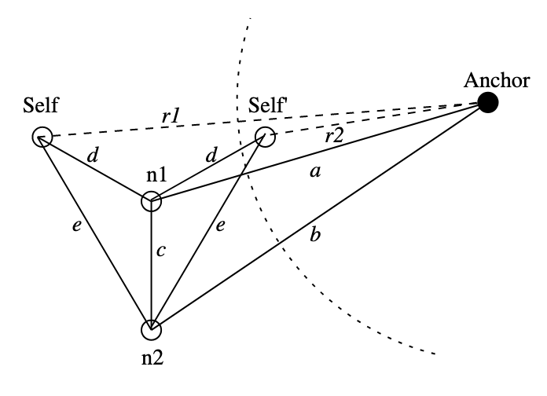
Distributed localization in wireless sensor networks: a quantitative comparison (langendoen et al 2003)

Slide 25
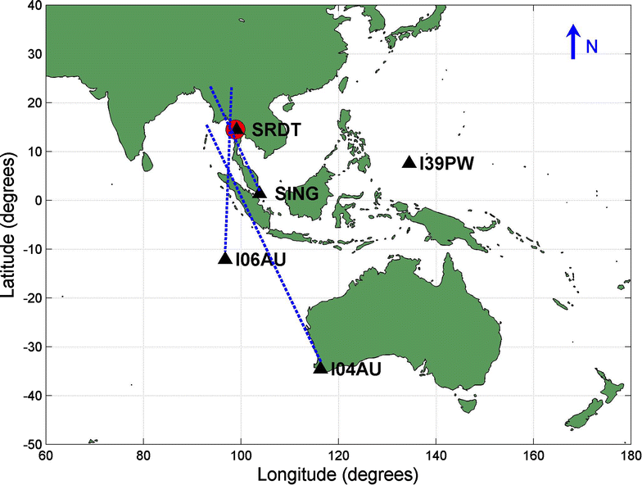
Infrasound and seismic detections associated with the 7 September 2015 Bangkok fireball (Caudron et al 2016)

Slide 26
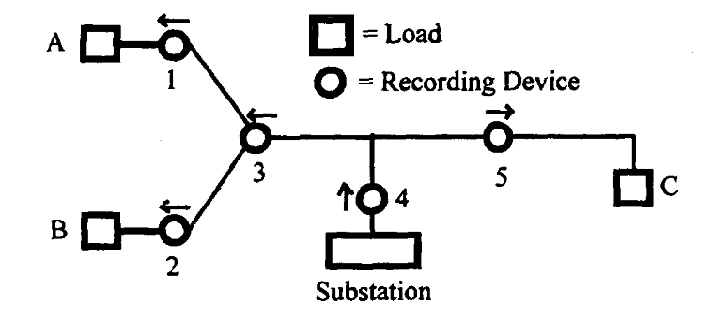
A Direction Finder for Power Quality Disturbances Based Upon Disturbance Power and Energy (PARSONS et al 1998)

Slide 27
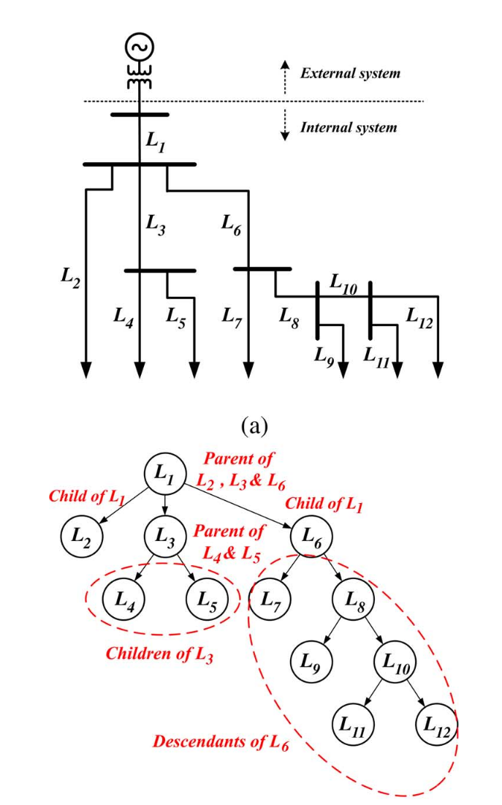
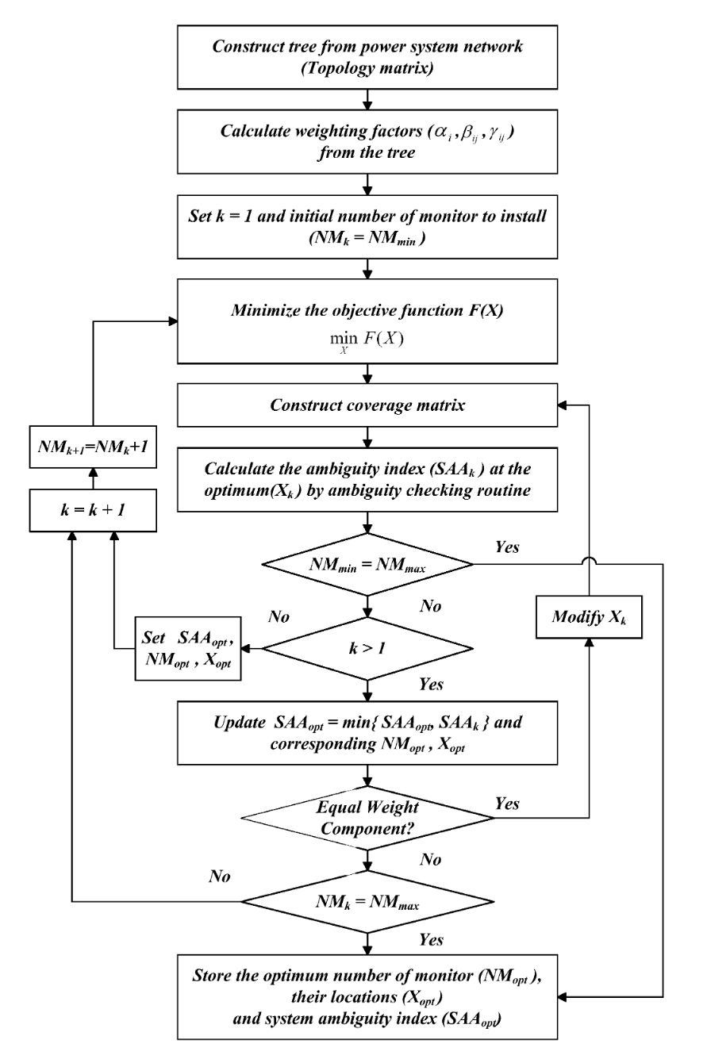
Optimal Number and Locations of Power Quality Monitors Considering System Topology (won et al 2008)

Slide 28
Optimizations for triggering

Slide 29
Wireless integrated network sensors (pottie et al 2000)

Slide 30
An Adaptive Sampling Algorithm for Effective Energy Management in Wireless Sensor Networks With Energy-Hungry Sensors (Alippi et al 2010)

Slide 31
topology Control in Wireless Ad Hoc and Sensor Networks (SANti 2005)

Slide 32
Laha design: converting primitive data into actionable insights & sensor big data management

Slide 33
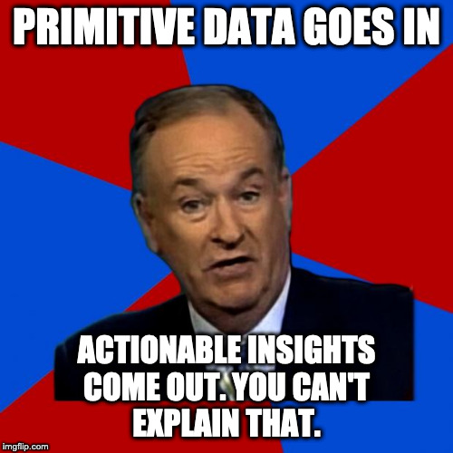

Slide 34
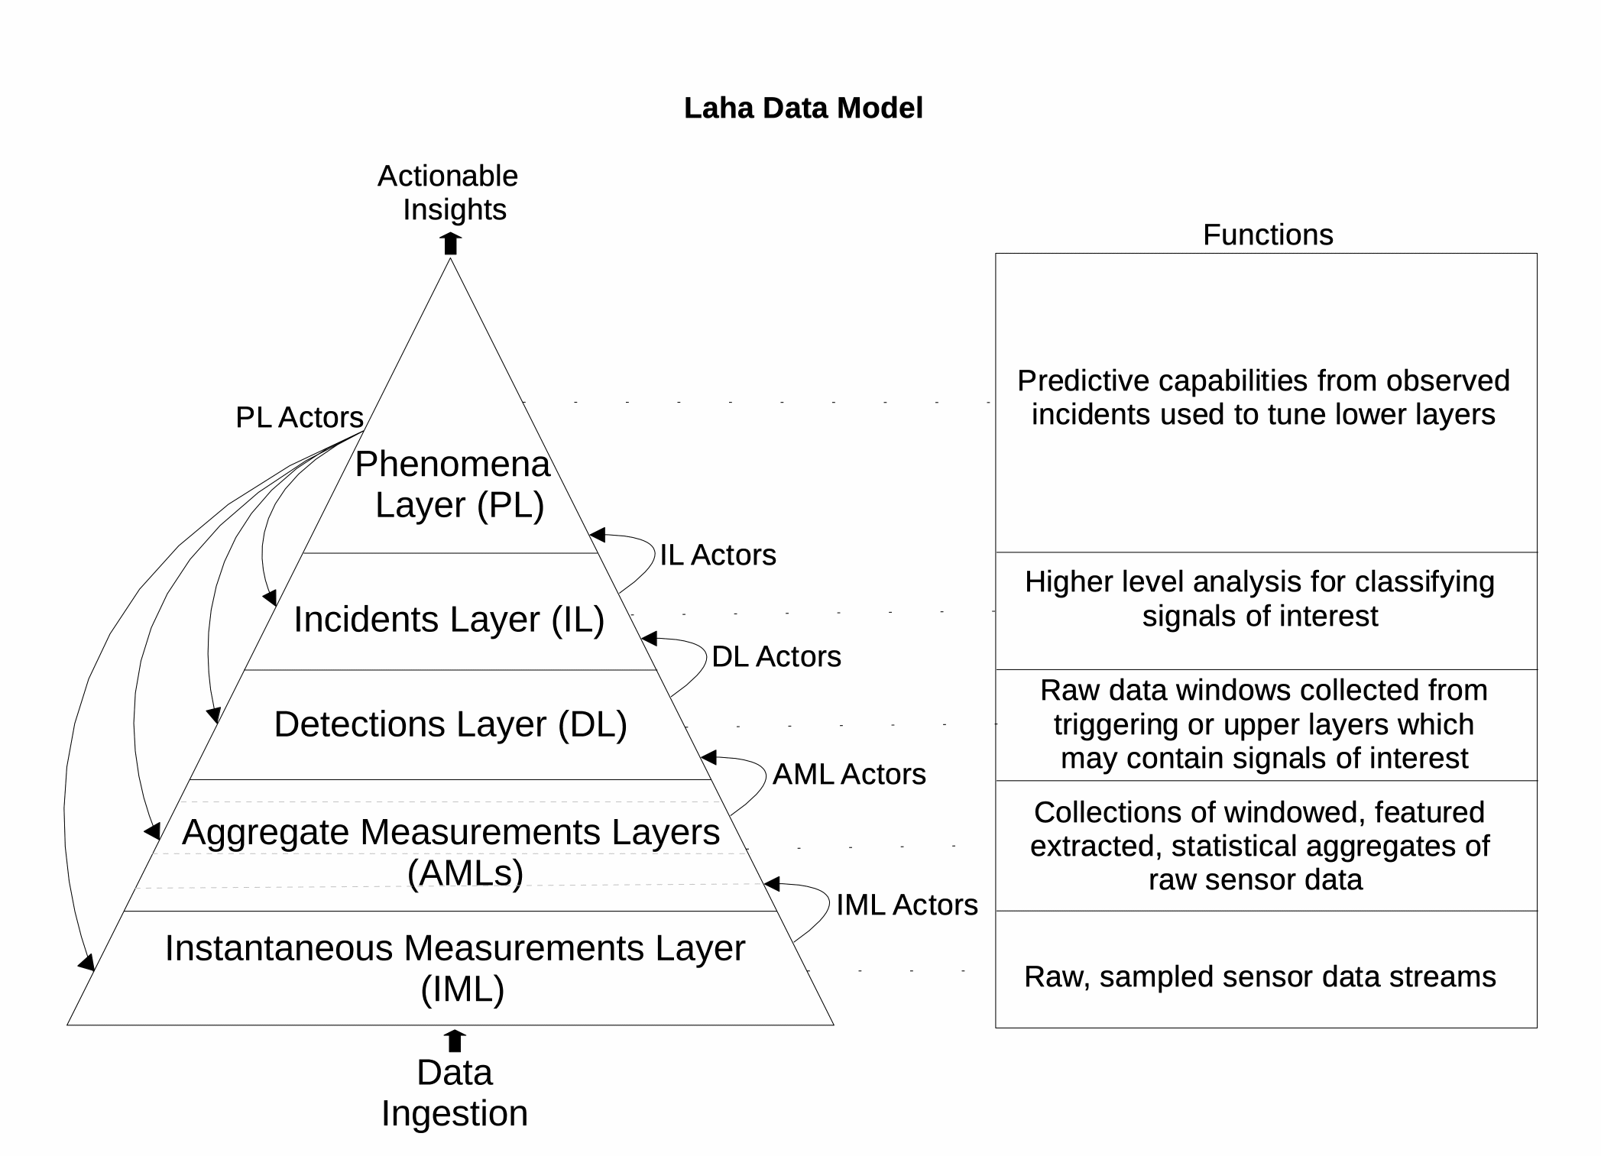
Design: Laha
Primitive data goes in
Actionable insights come out

Slide 35
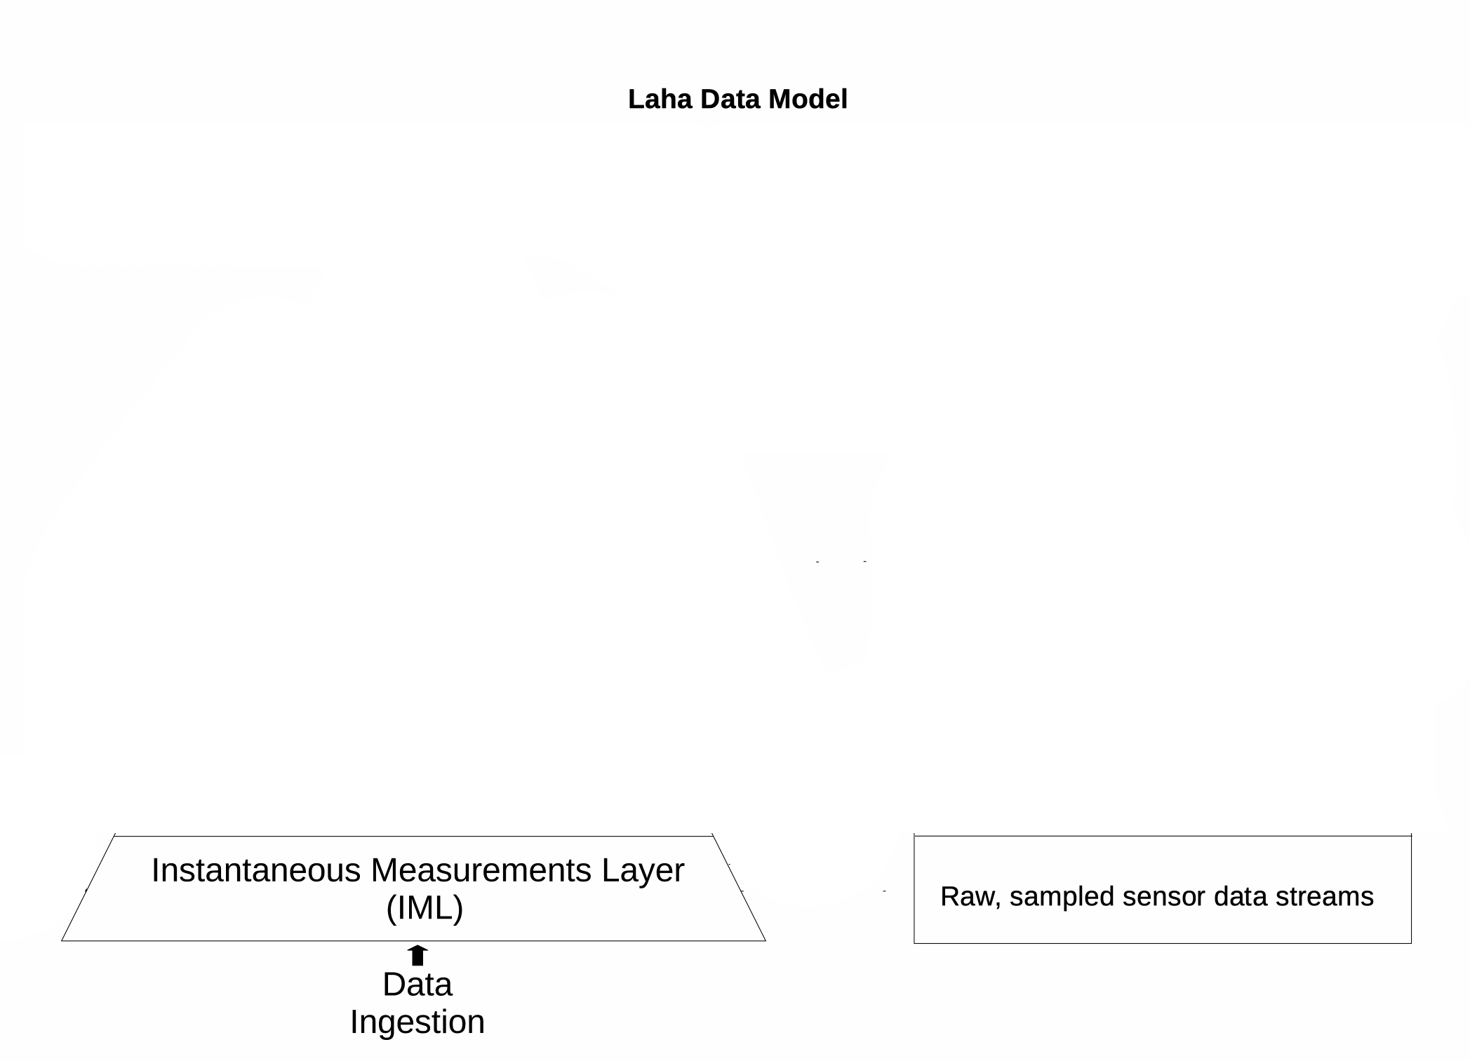
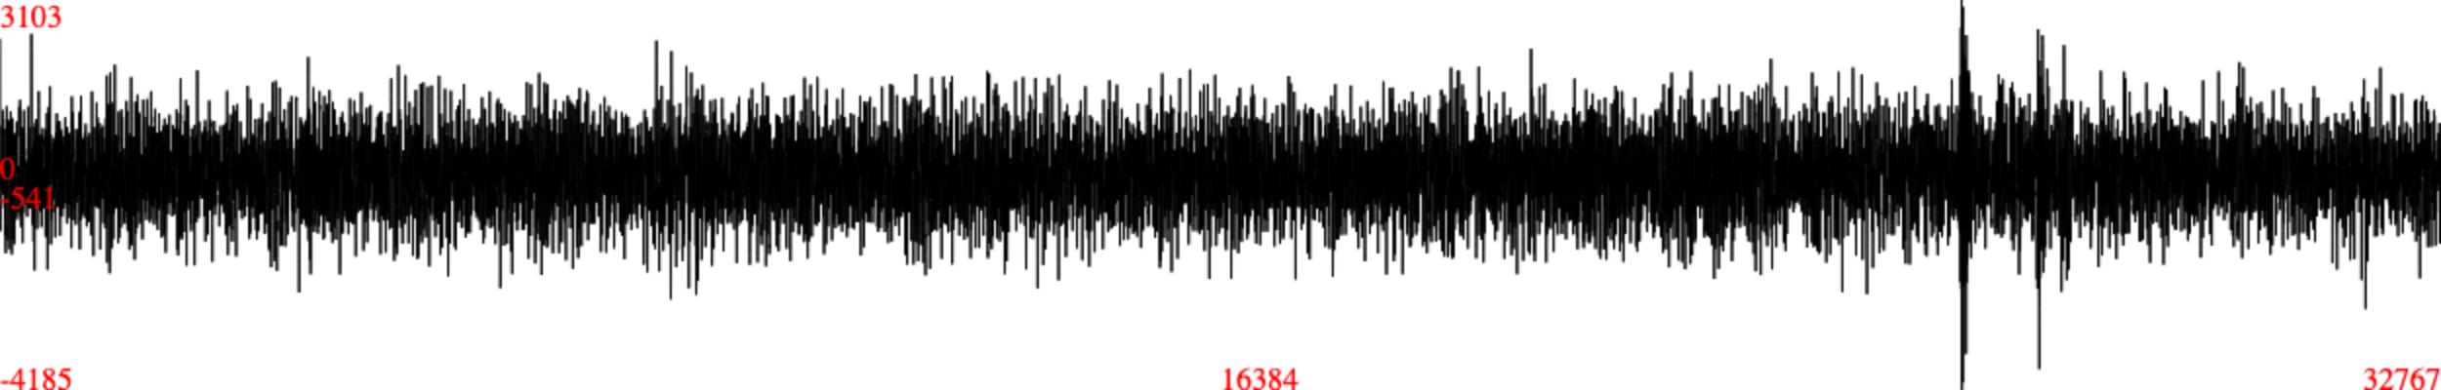
Design: LAHA IML
Raw Sensor Samples
TTL
15 Minutes

Slide 36
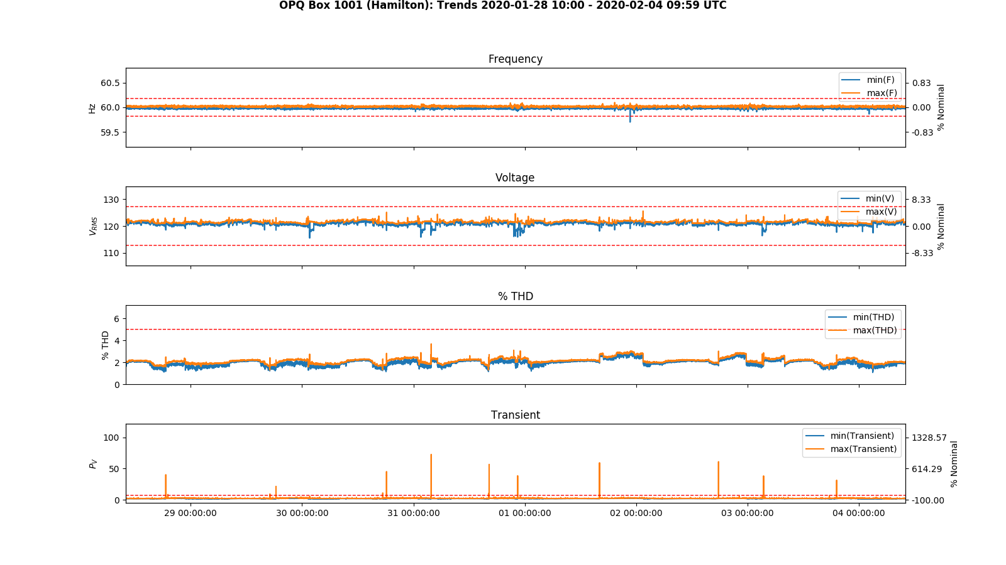
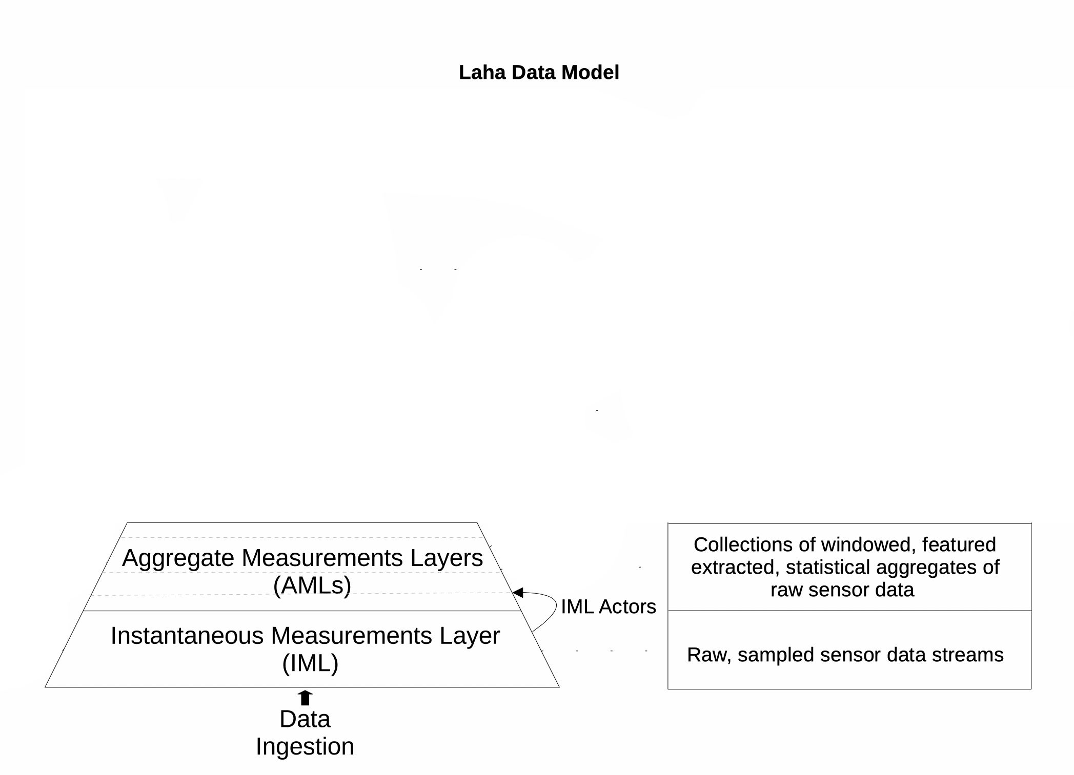
Design: LAHA AML
Summary statistics of extracted features
TTL
24 Hours
2 Weeks

Slide 37
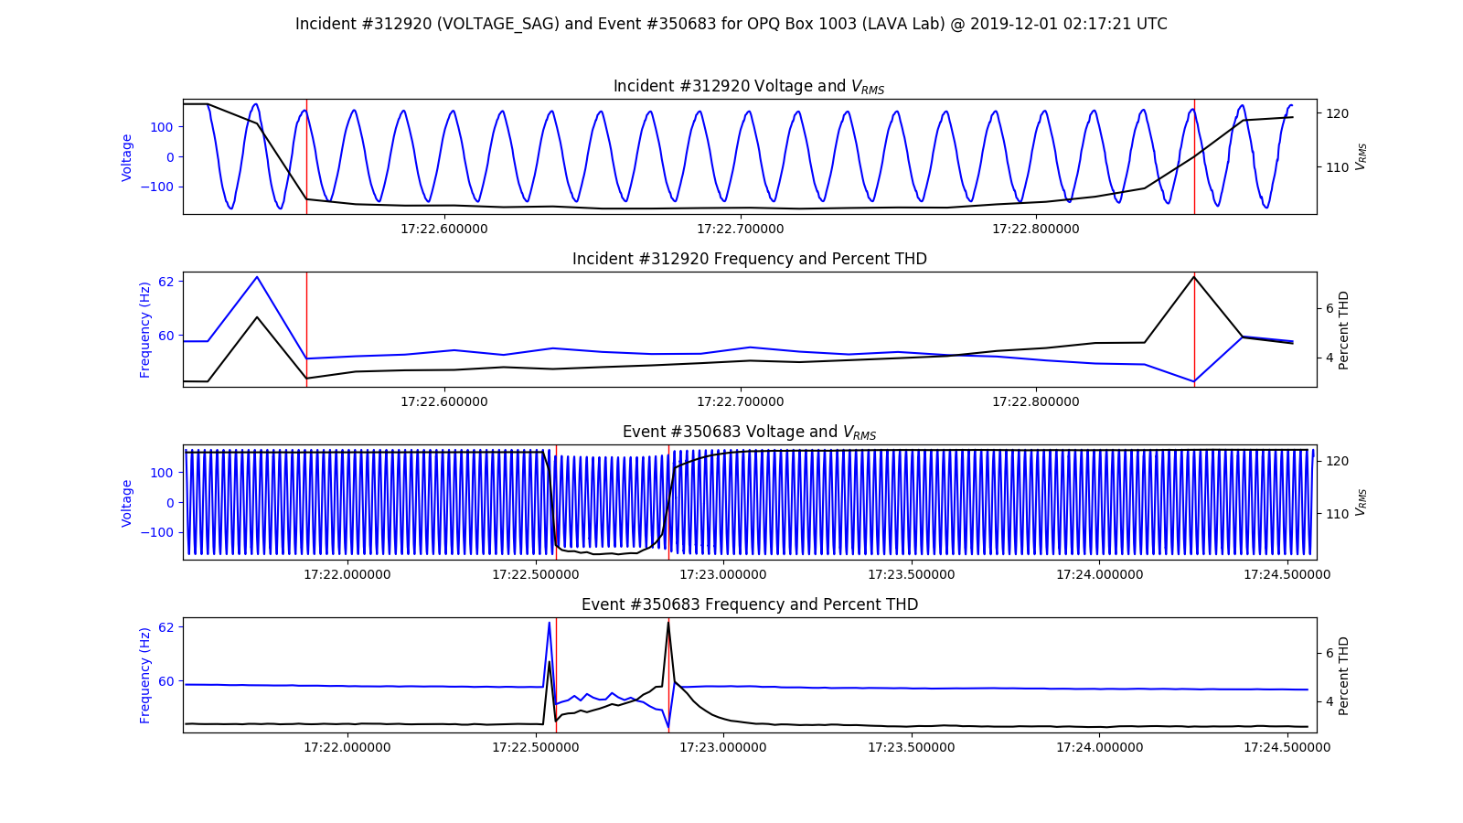
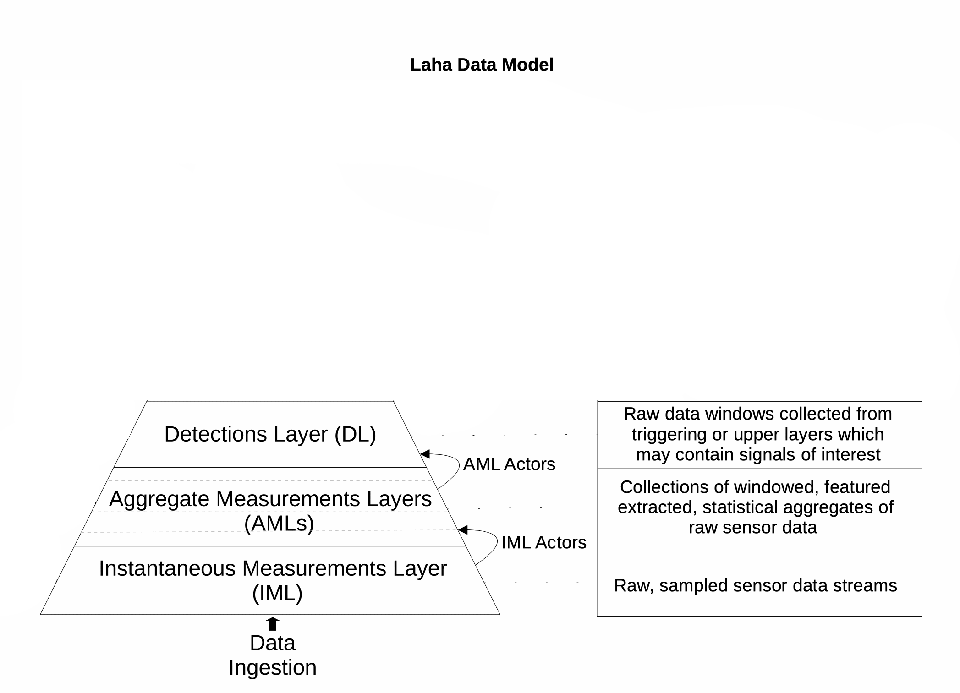
Design: LAHA DL
Window containing potential signals of interest
TTL
1 Month

Slide 38
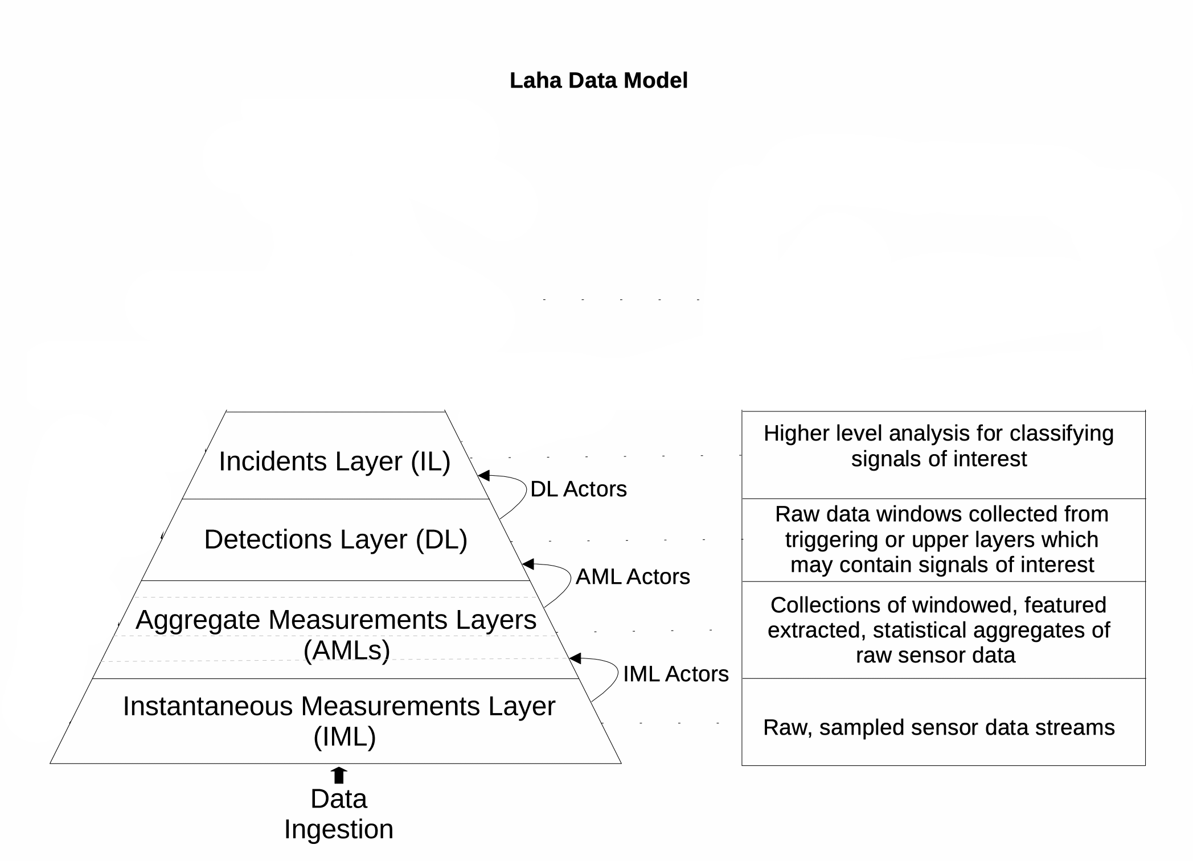
Design: LAHA IL
Window containing classified signals of interest
TTL
1 Year

Slide 39
Design: Laha PL
Actional insights
Predictive analytics
Data grouping
TTL
2 Years

Slide 40
Design: Phenomena
Phenomena provide
Self-optimization
Actionable insights through
Predictive analytics
Ability to group data
Phenomena
Annotation
Locality
Periodic
Similarity
Future

Slide 41
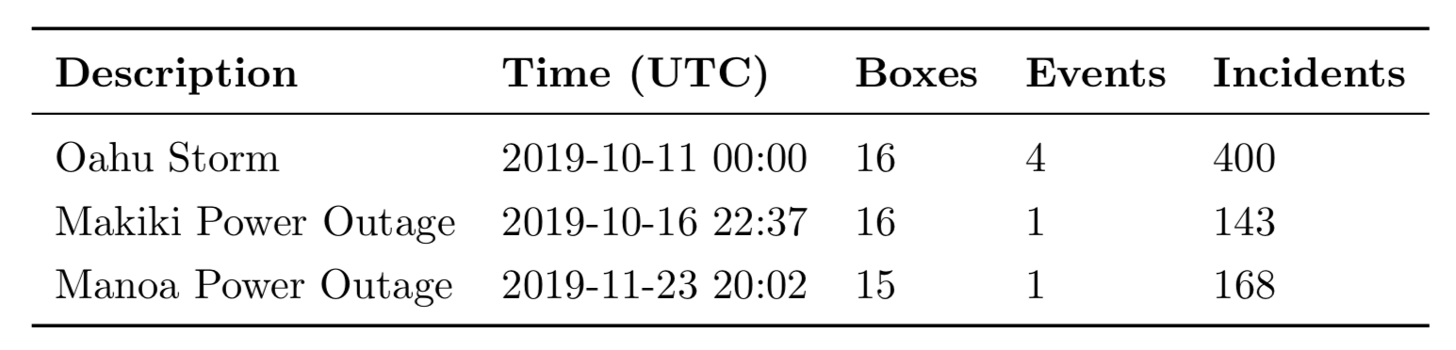
DESIGN: ANNOTATION PHENOMENA

Slide 42
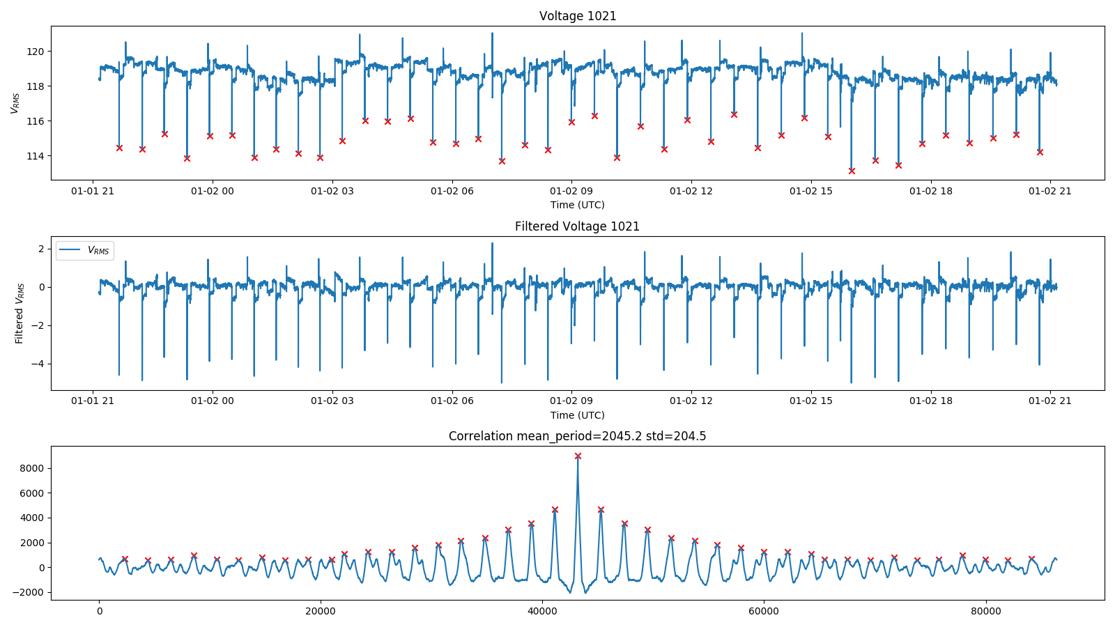
DESIGN: periodic PHENOMENA

Slide 43
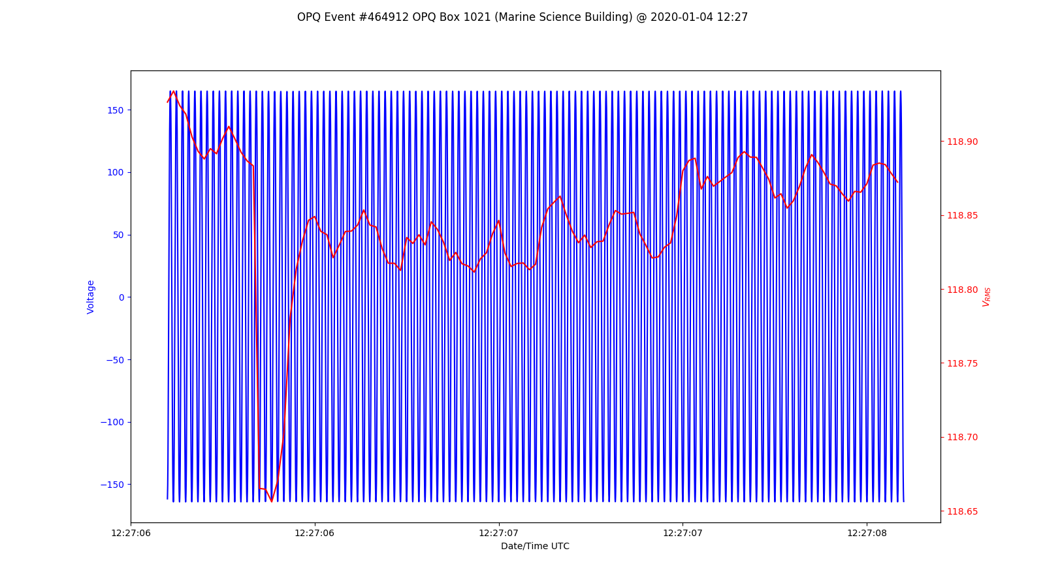
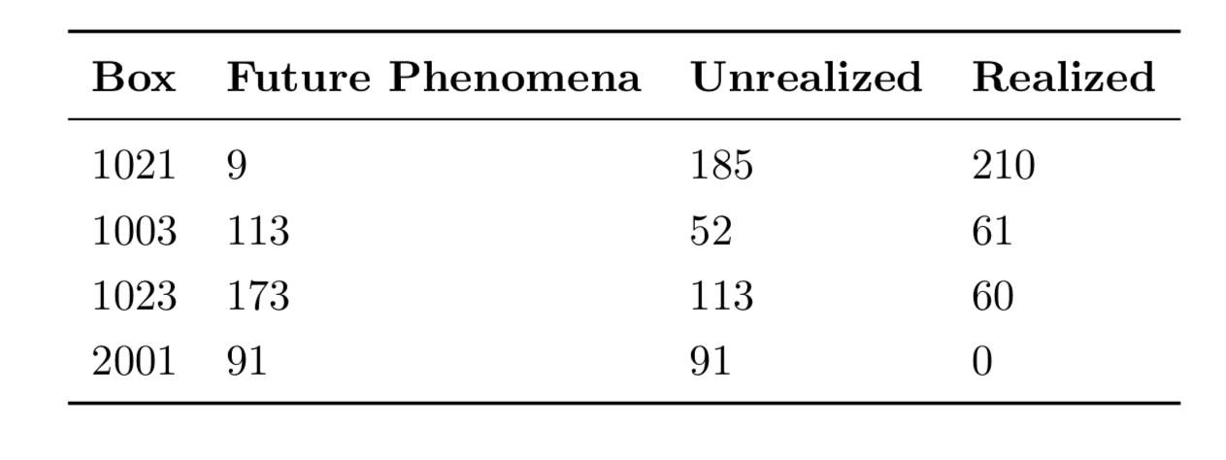
DESIGN: FUTURE PHENOMENA

Slide 44
Design: periodic & future phenomena SELF-OPTIMIZATION
Used to create Future Phenomena
Periodic
Phenomena
Future
Phenomena
Increases Measurement rate and
decrease detection thresholds
enabling more accurate Periodic
Phenomena

Slide 45
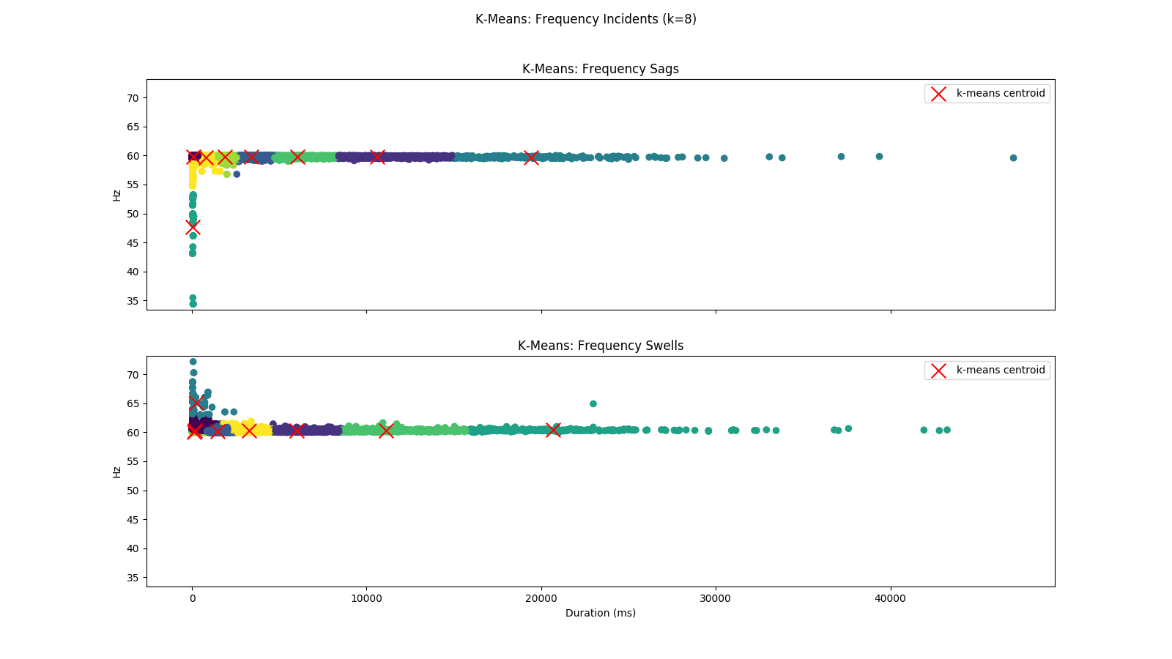
DESIGN: SIMILARITY PHENOMENA

Slide 46
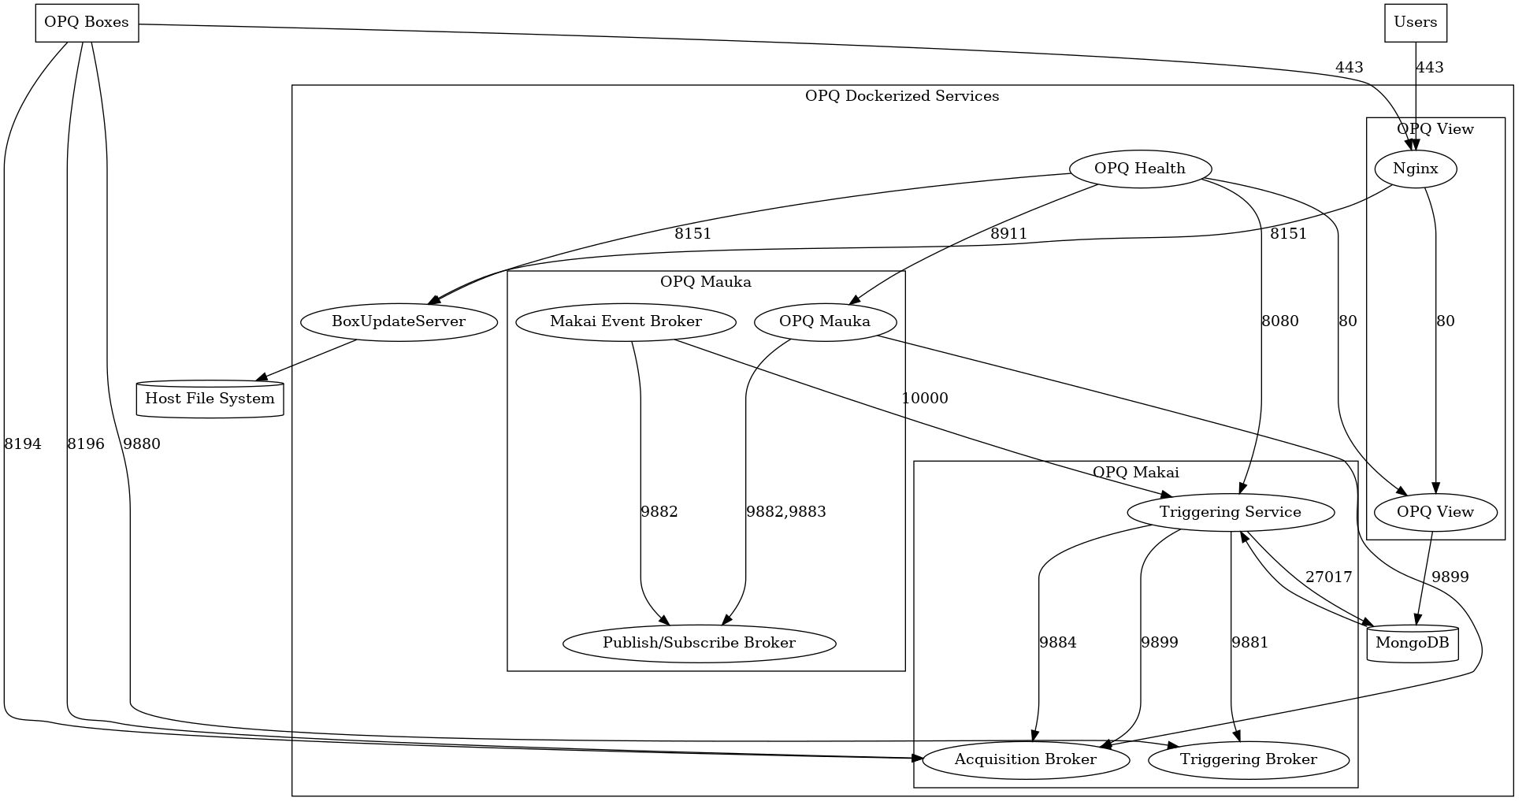
Design of OPQ
OPQ consists of distributed services
Box
Makai/Napali
Mauka
Health
View
MongoDB

Slide 47
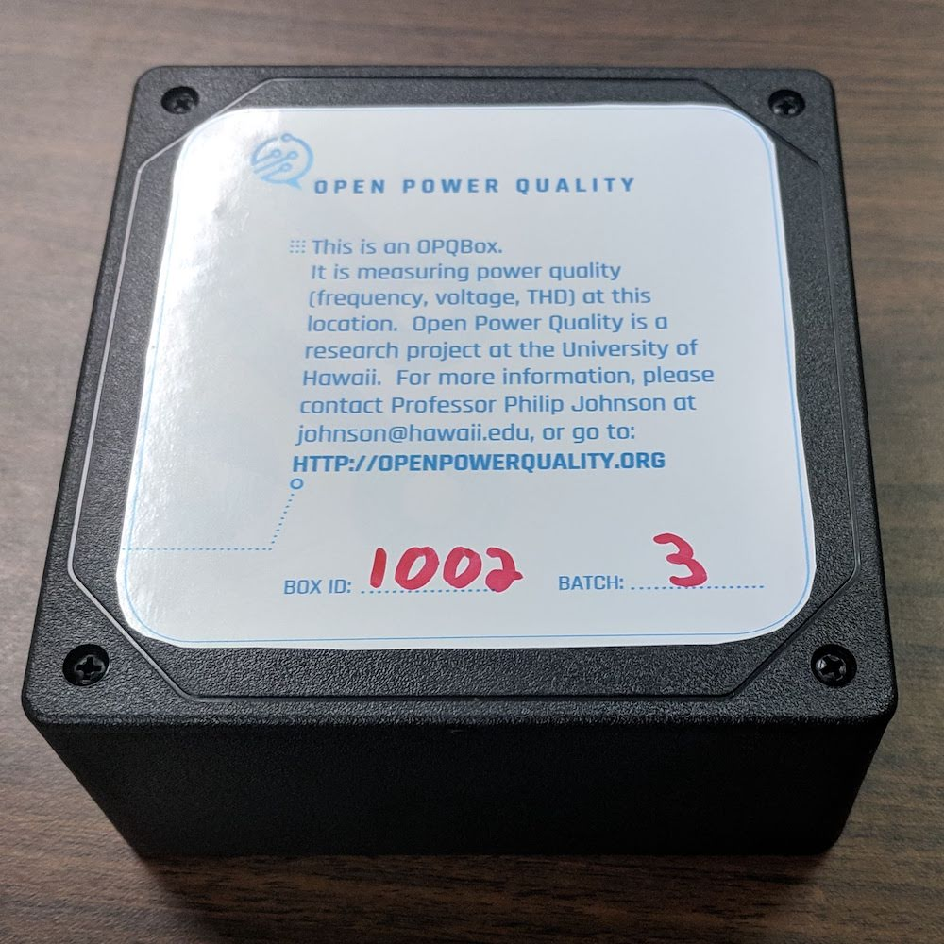
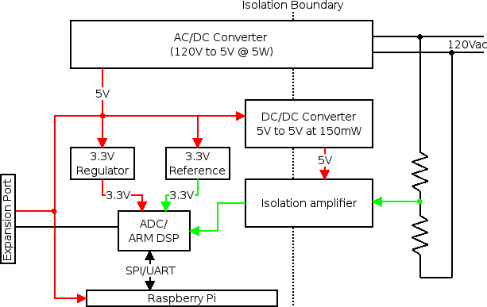
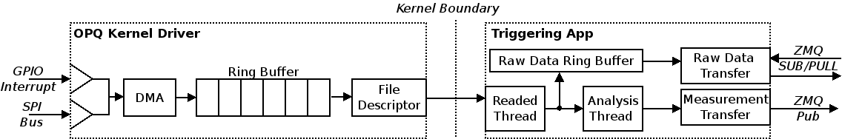
OPQ: Box
Open Source PQ Sensor
12 kHz sampling
Wireless encrypted comms.
Trigger based acquisition
Negrashov 2020

Slide 48
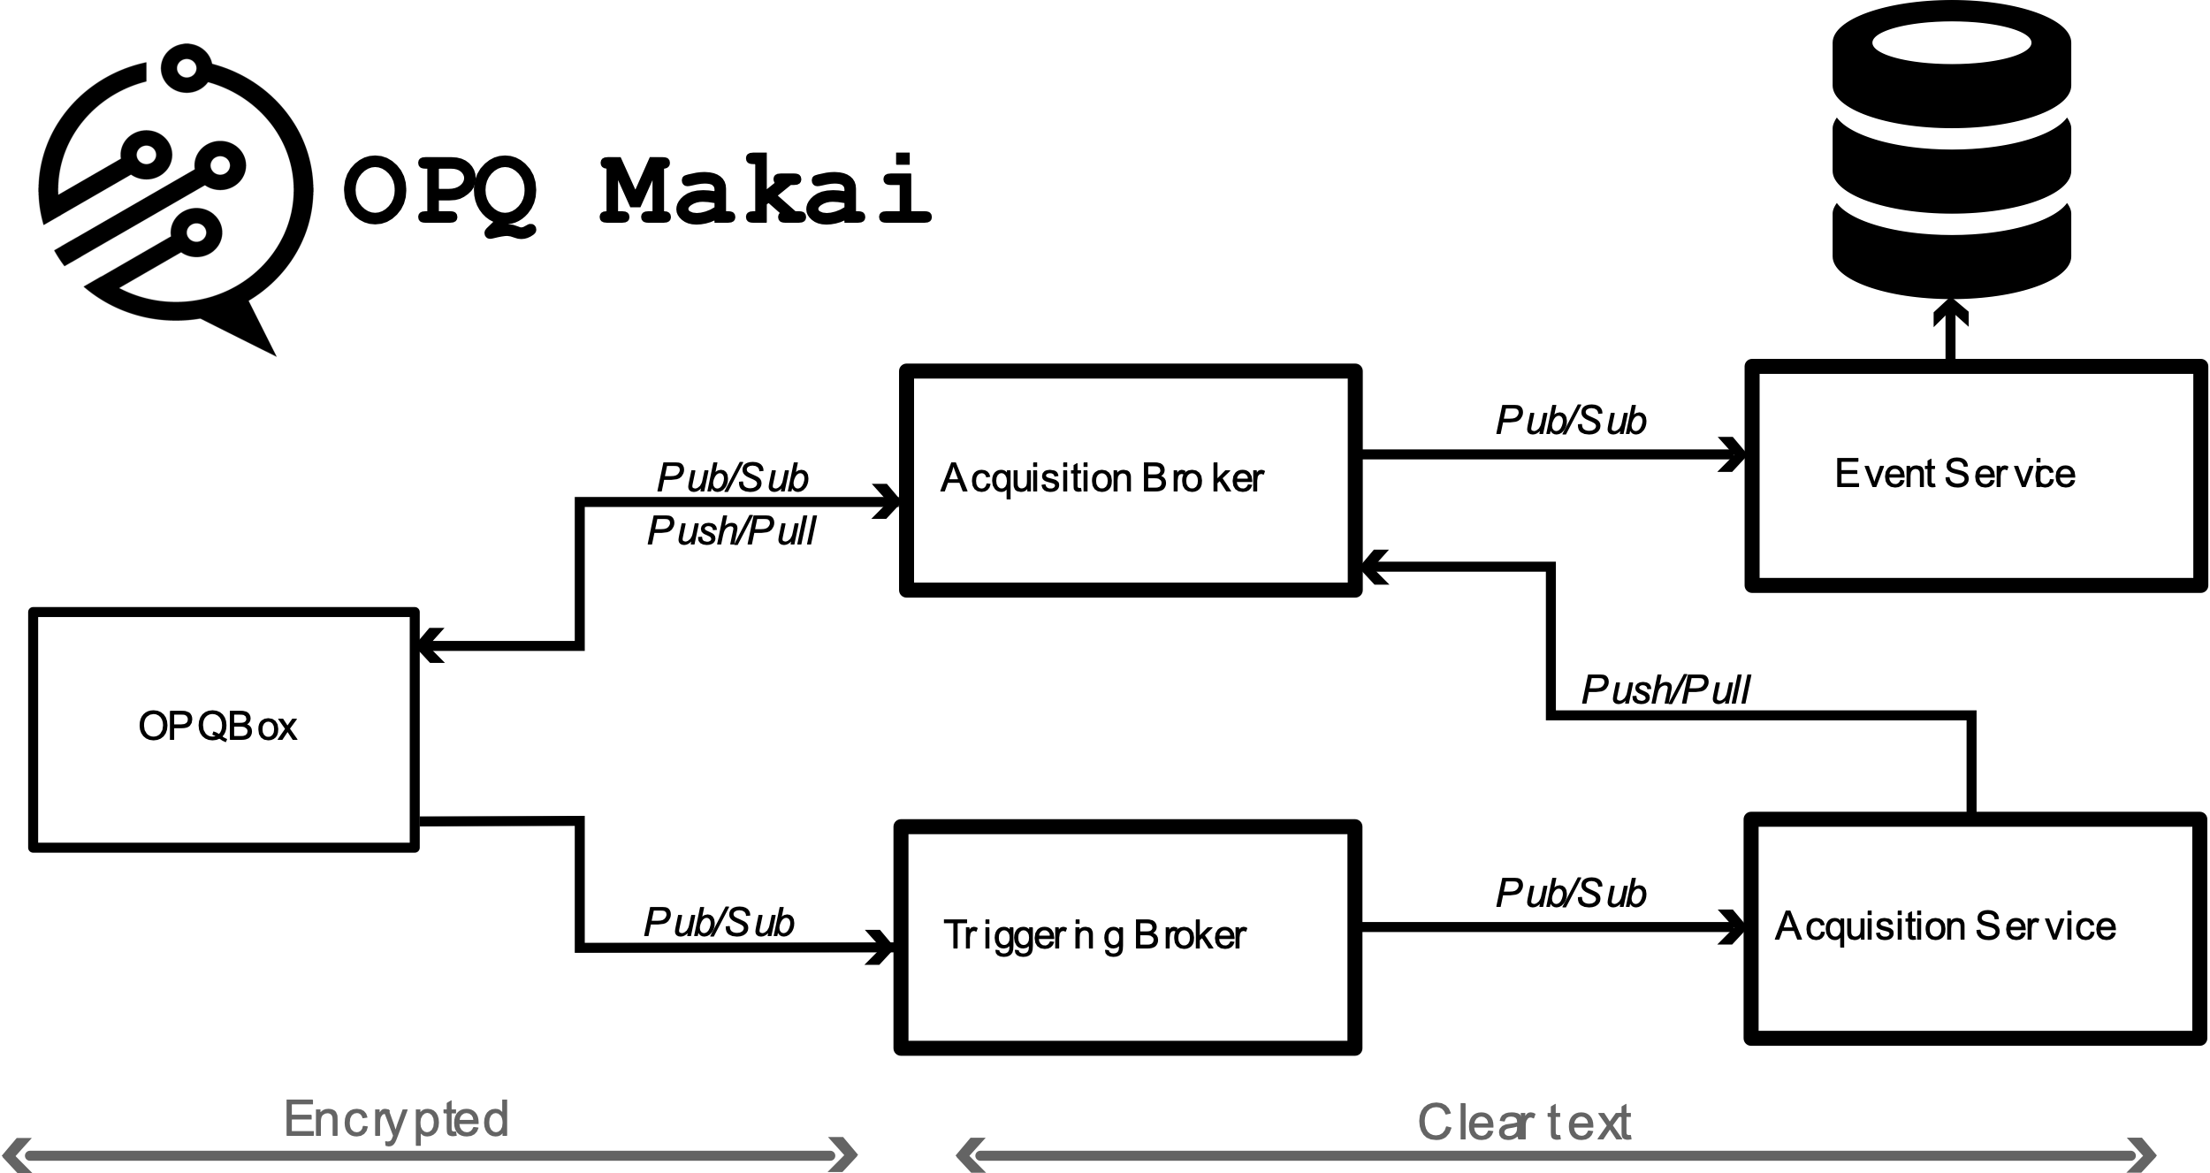
OPQ: Makai/napali
Data acquisition
Triggering
Box communication broker
Negrashov 2020

Slide 49
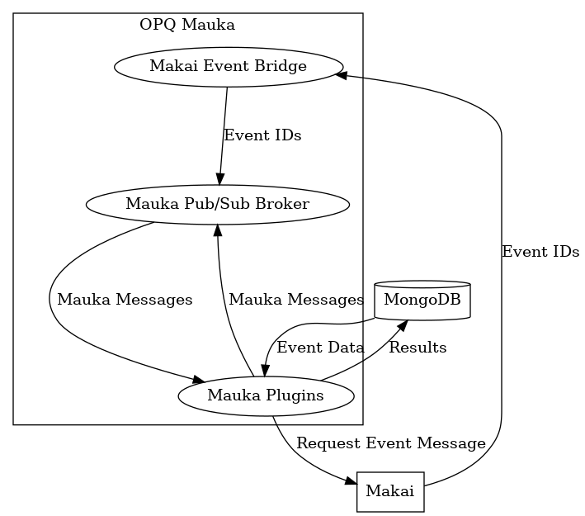
OPQ: mauka
PQ Analysis
Predictive Analytics
Garbage Collection
PQ Plugins (Laha Actors) Providing:
Annotations, base, box optimization, frequency analysis, future phenomena, IEEE1159 voltage analysis, ITIC classification, GC, Makai Event service, mocking capabilities, outage detection periodicity analysis, debugging, Semi-F47 classification, system health/status, metric collection, THD analysis, threshold optimization, transient detection, and triggering

Slide 50
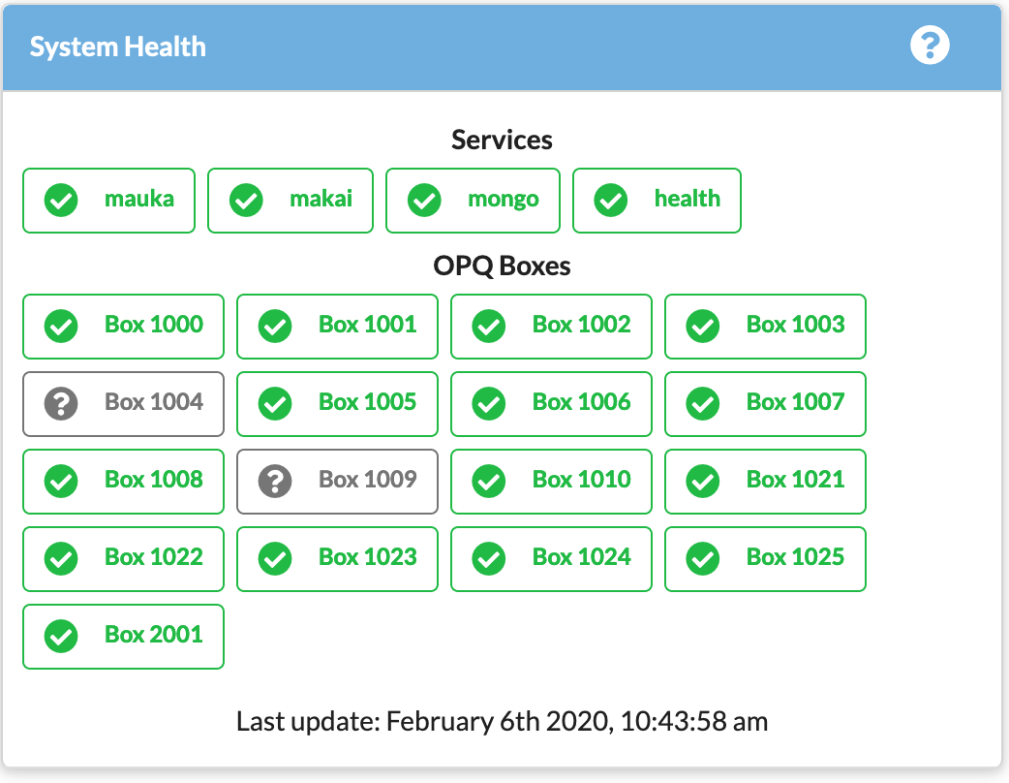
OPQ: Health
Box Monitoring
Service Monitoring
Configurable Alerts

Slide 51
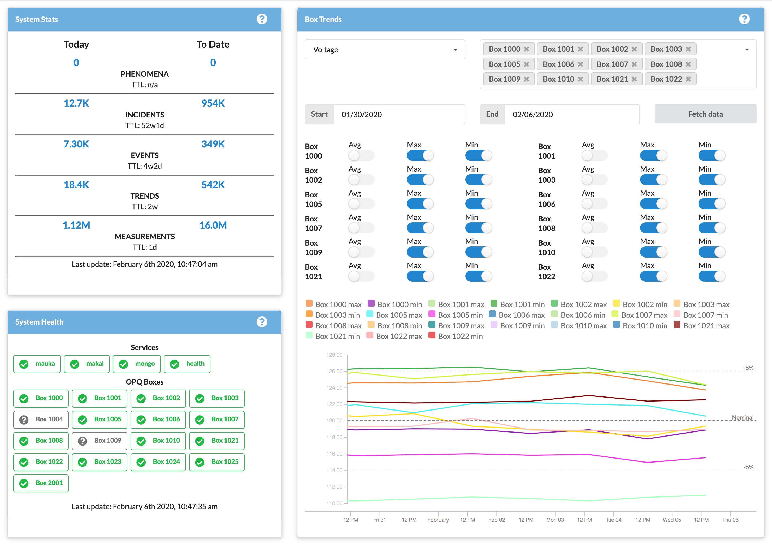
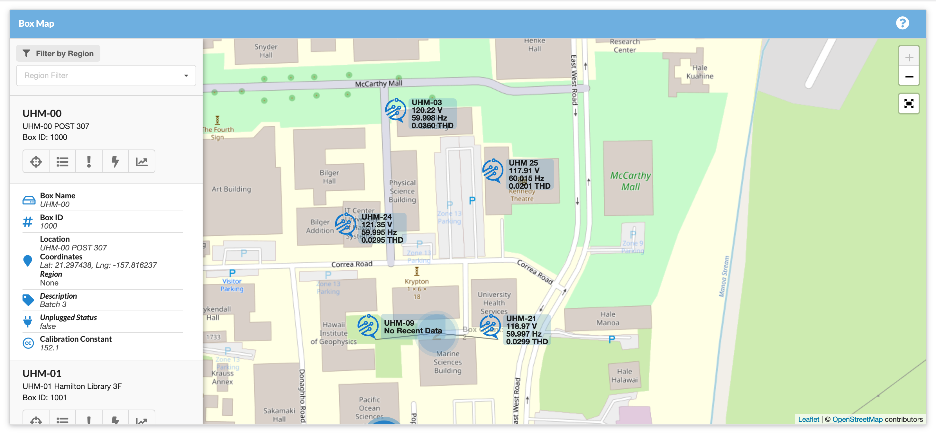
OPQ: view

Slide 52
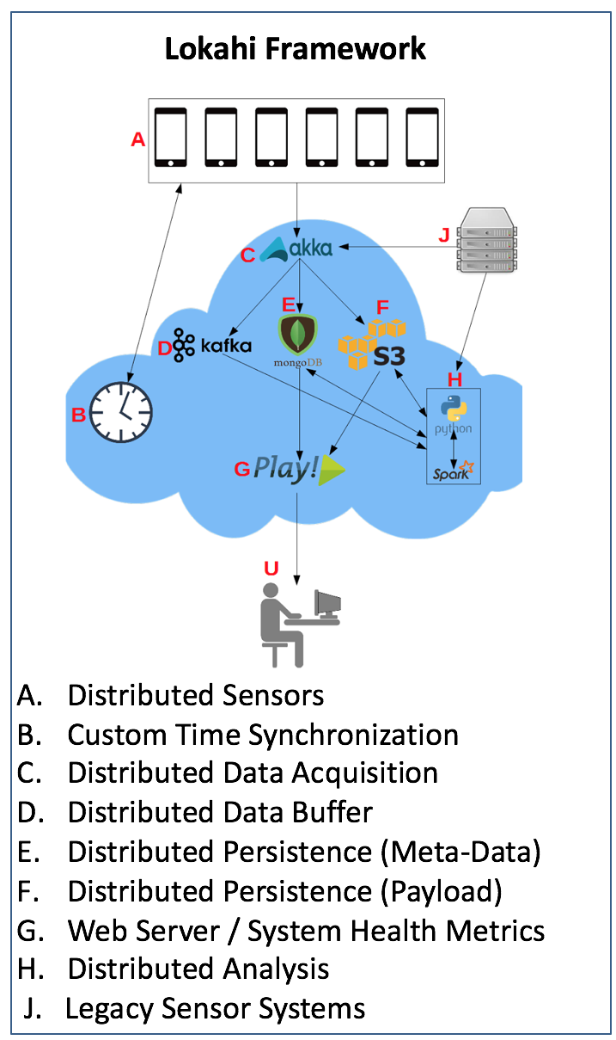
Design of lokahi
Lokahi is made up of several distributed services
Lokahi Sensors
Time Synch Service*
Acquisition Service
Web Service
Analysis Service
Collaboration Service*

Slide 53
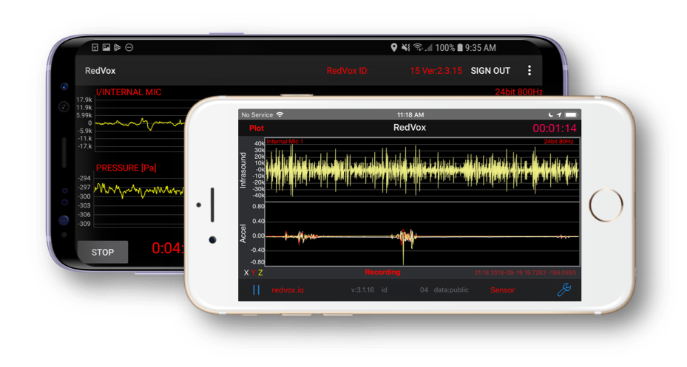
Lokahi: sensors

Slide 54
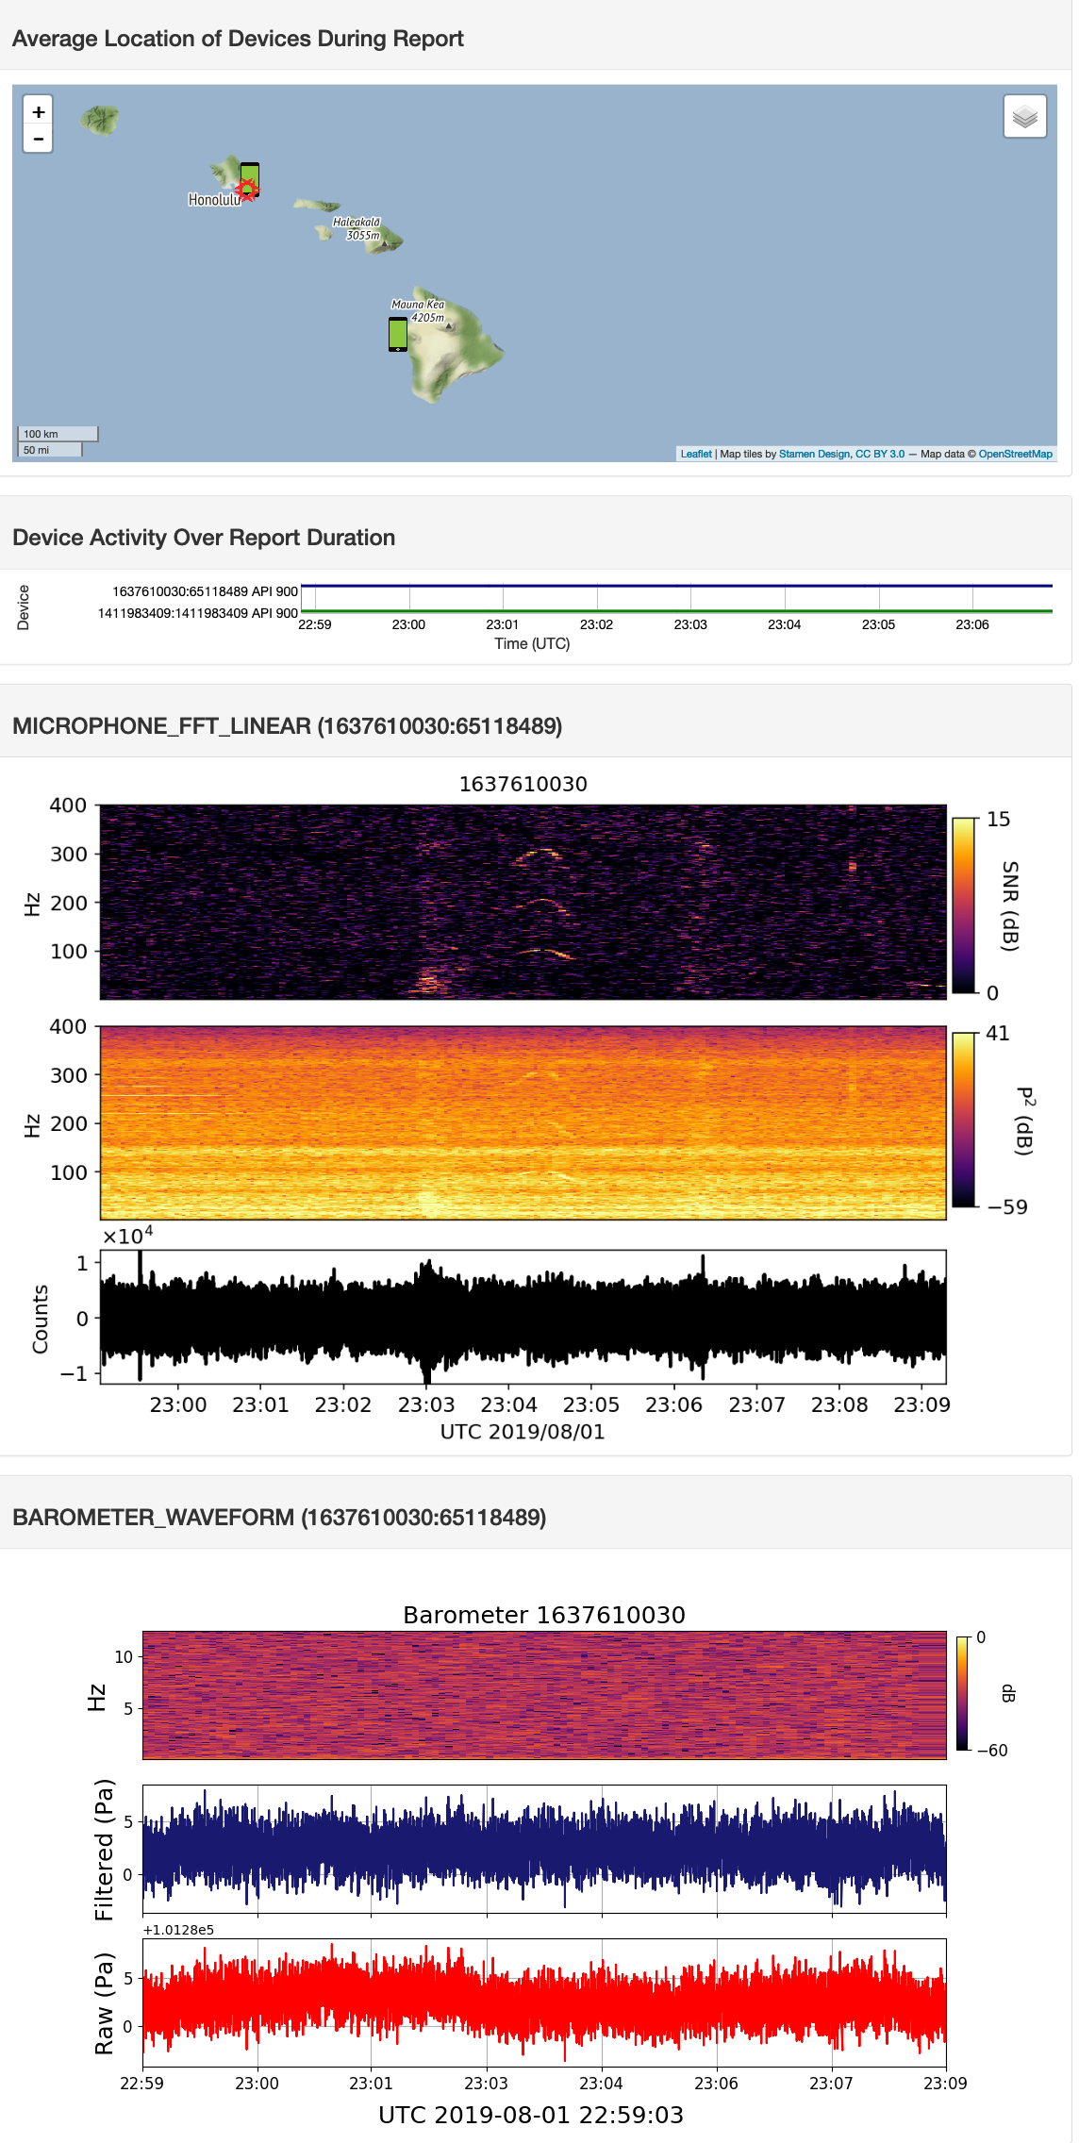



LOKAHI: Web

Slide 55


Lokahi: Analysis
Big Island earthquake
SpaceX launch
Meteor entry above Maui

Slide 56
Evaluation techniques

Slide 57

Evaluation: Deployment of laha reference implementations
OPQ UHM Locations
Accessibility
Co-location with UHM sensors
Topology of UHM micro-grid
Lokahi Locations
Ad-hoc public sensor data

Slide 58


Evaluation of data validation
OPQ
Compare against
GE PQMII
GE EPM7000
Lokahi
Compare against
Bruel & Kjaer Microphone Type 4193
MB3 digital microbarometer
Asmar 2019

Slide 59
Evaluation of generality of laha framework

Slide 60
Evaluation of converting primitive data into actionable insights

Slide 61
Evaluation of big data sensor management

Slide 62
Evaluation of tertiary goals

Slide 63
RESULTS

Slide 64



Results of data validation
OPQ Events vs Ground Truth

Slide 65

Results of generality of laha: OPQ

Slide 66


Results of generality of laha: OPQ

Slide 67




Results of generality of laha: OPQ

Slide 68

Results of generality of laha: Lokahi
Full results available at redvox.io
Meteor Entry over Maui
SpaceX Falcon 9
Big Island Earthquake
Hurricane Lane

Slide 69
Results of converting primitive data into actionable insights: Laha level hierarchy

Slide 70
Results of converting primitive data into actionable insights: annotation phenomena
Description | Boxes | Events | Incidents
Oahu Storm | 16 | 4 | 400
Makiki Outage | 16 | 1 | 143
Manoa Outage | 15 | 1 | 168

Slide 71

Results of converting primitive data into actionable insights: PERiodic phenomena

Slide 72

Results of converting primitive data into actionable insights: FUTURE phenomena

Slide 73



Results of converting primitive data into actionable insights: similarity phenomena

Slide 74



Results of tiered management of big data: OPQ

Slide 75



Results of tiered management of big data: Lokahi

Slide 76
Results of tertiary goals
Used to create Future Phenomena
Adaptive optimizations for triggering
Dynamically alter measurement rate (1Hz->6Hz)
Adaptive optimizations for detection/classification
Dynamically alter thresholds
37/210 predicted events are sub-threshold
Model of Underlying Sensor Field Topology
Requires more detailed knowledge of grid
Periodic
Phenomena
Future
Phenomena
Increases Measurement rate and
decrease detection thresholds
enabling more accurate Periodic
Phenomena

Slide 77
Discussion on laha suitability for dsns
Sensor Sampling Rate
Network Uptime
Signal-to-Noise
Data Acquisition
Sensor Availability
Numerous Events
Multiple Signal Classifications
Designed for Laha
Other DSNs

Slide 78

Discussion on laha levels
SML*
IML
AML
DFL*
DL
IL
PL

Slide 79
conclusions

Slide 80
Future directions
Machine learning
Modifying windows and thresholds
Additional simulations
Altering the Level-hierarchy
Enhanced metric collection
Expanded sensor coverage

